Slide 1
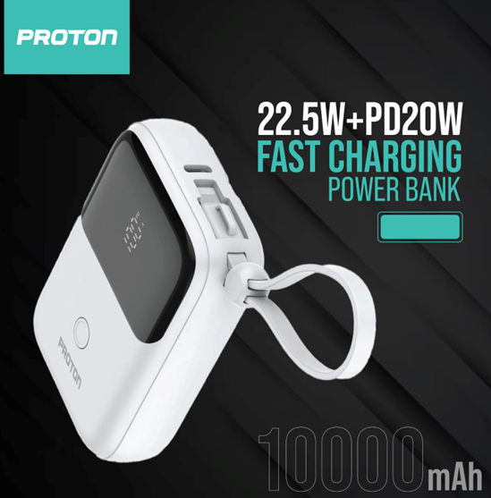
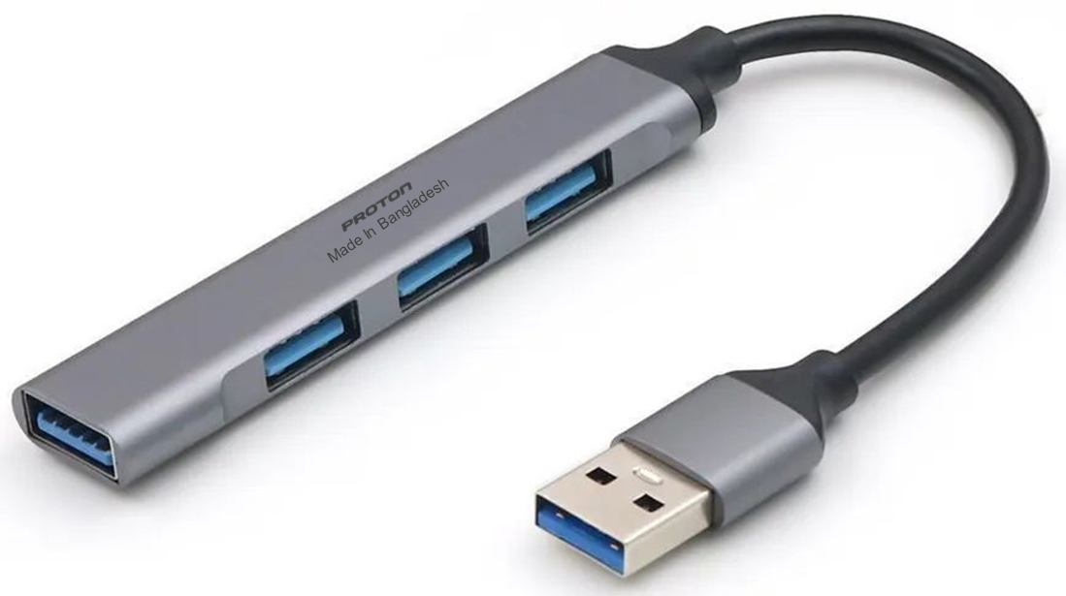
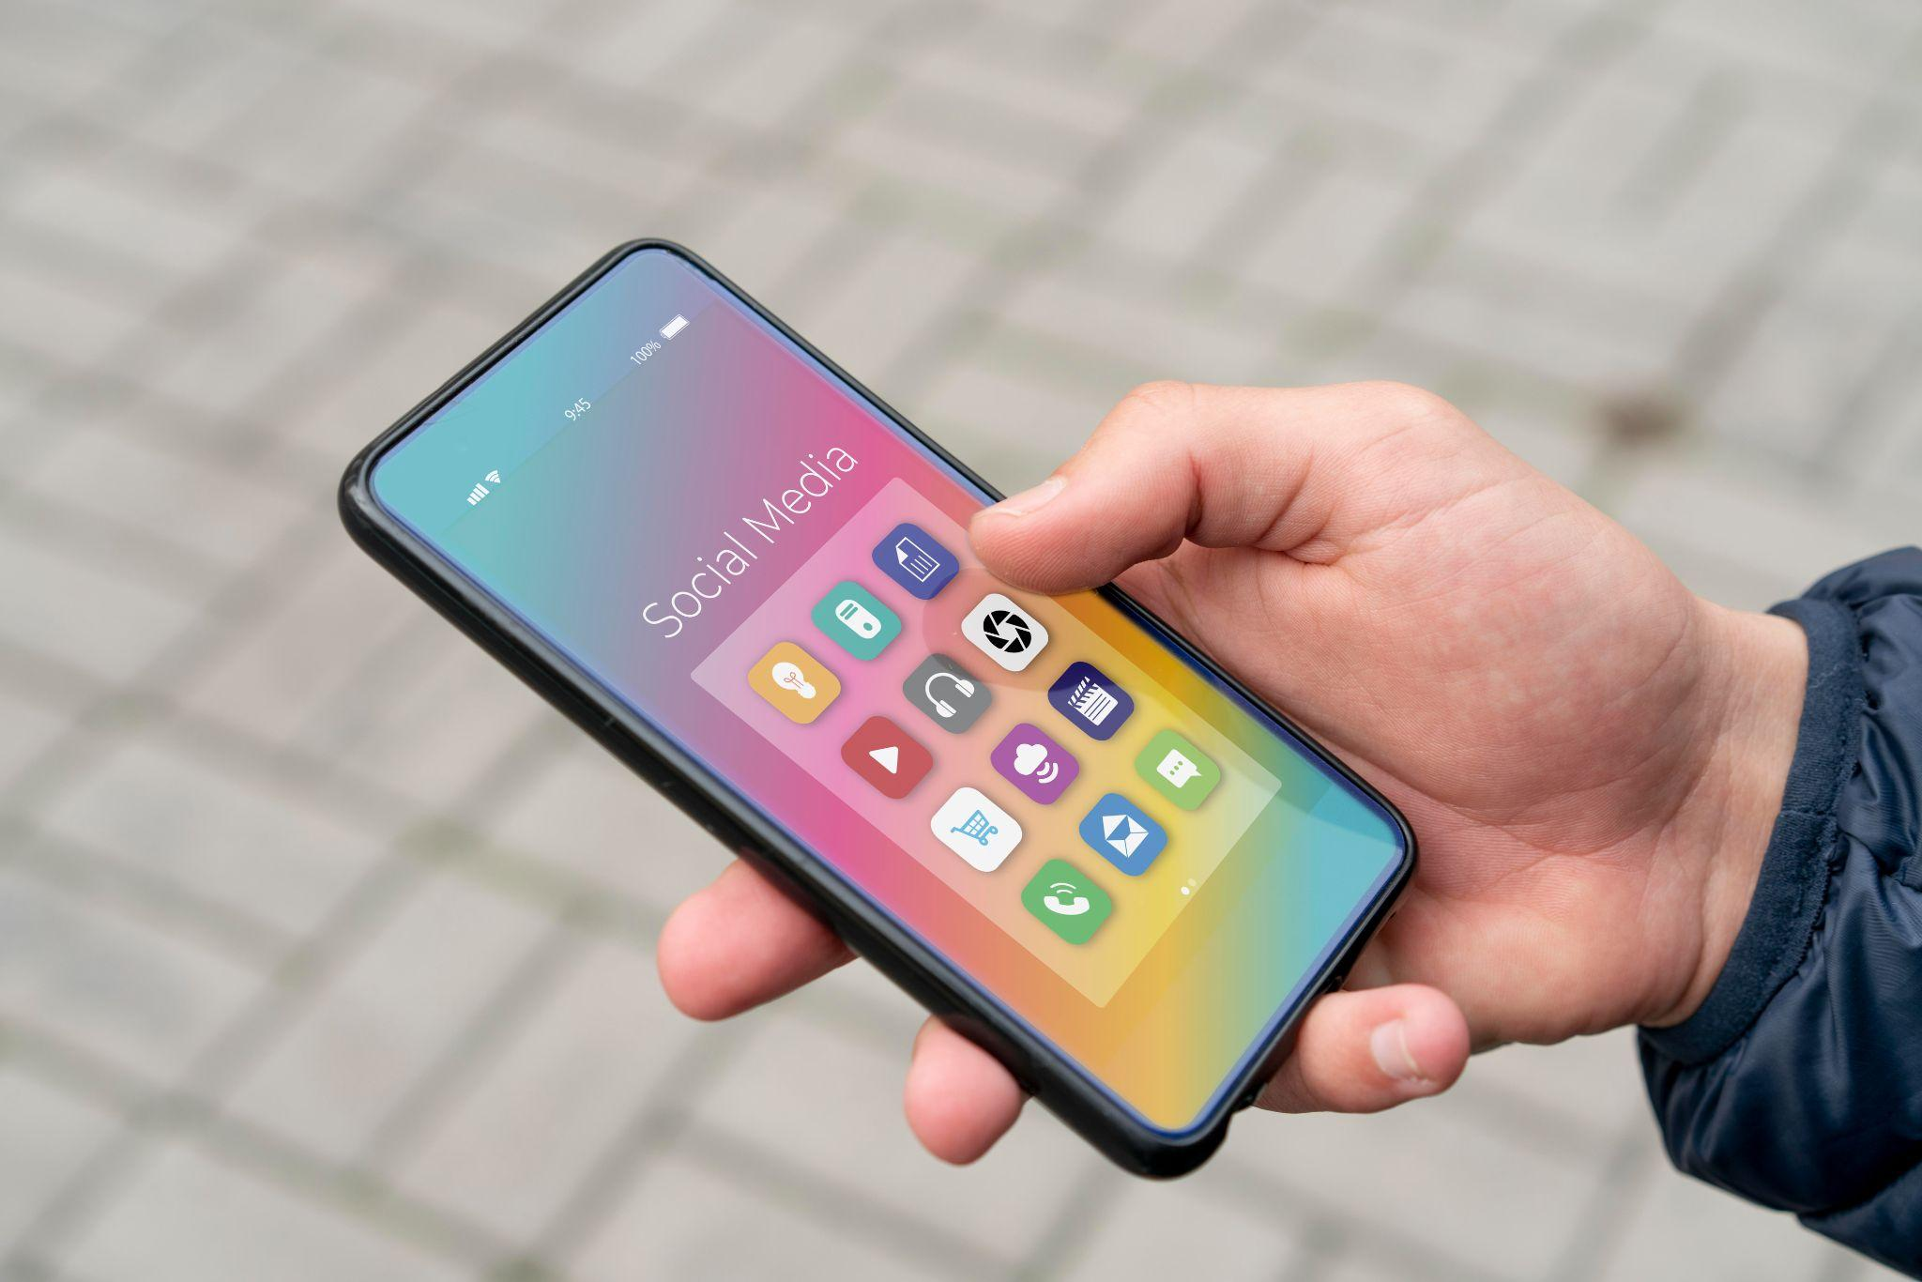
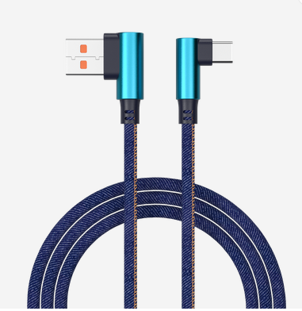
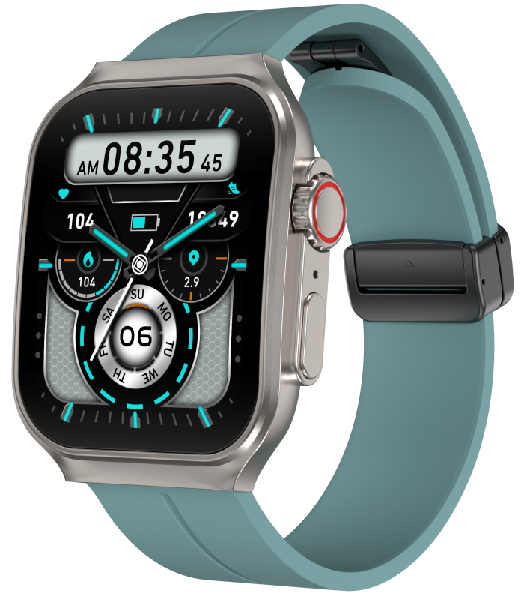
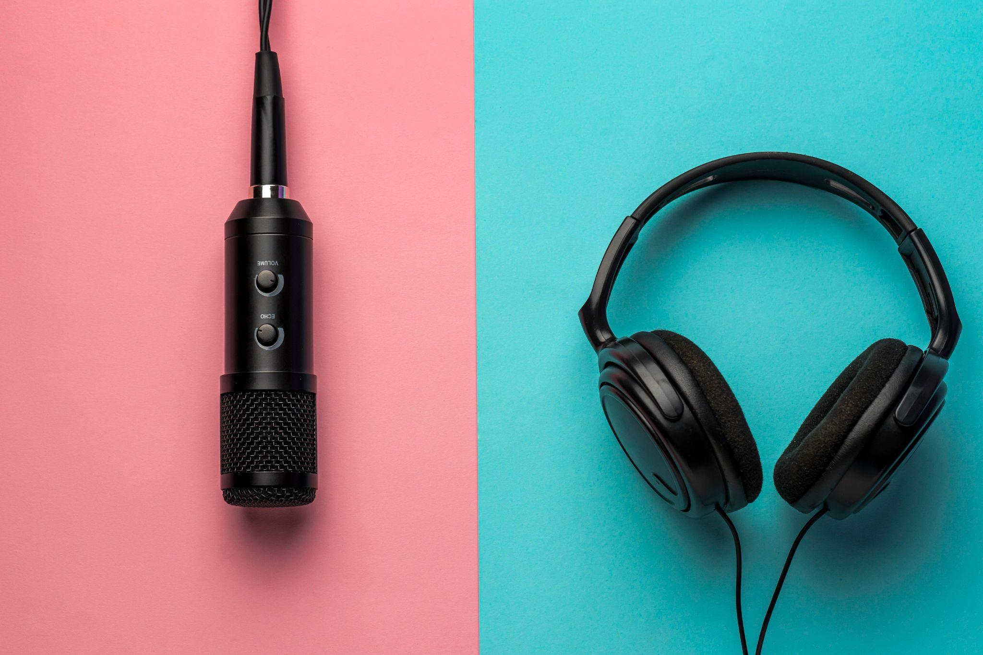
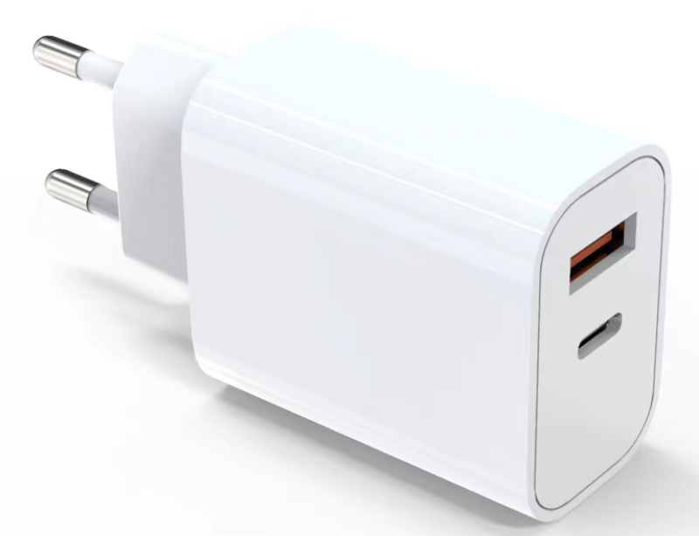

Products
Mobile
Music
Charger
Cable
Powerbank
Smartwatch
IT
Upcoming : 6
Upcoming : 3
Upcoming : 3
Upcoming : 1
Upcoming : 2
Upcoming : 2
Upcoming : 2

Slide 2
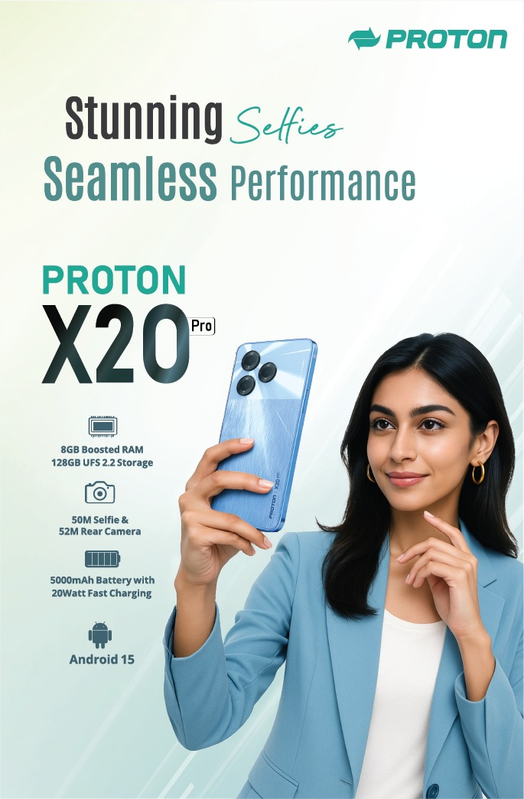
Smart Phone – X20 Pro
Features :
Display: 6.6” Punch Hole LCD HD+ IPS INCELL 2.5D 20：9 120Hz Touch Sampling Rate
Immersive Punch hole LCD
RAM: 8GB Boosted * RAM ( 4+4) ,
ROM: 128GB (Expandable Upto 1TB) DDR4X+UFS2.2 Super High-Speed Memory
Rear Camera : 52MP AI Dual Camera
Front Camera: 50M Selfie
Processor : Unisoc T615 SoC Octa Core | TSMC，12nm | 2*A75@2.2GHz + 6*A55@1.8GHz,
GPU - Mali G57 MP1@850MHz
Battery : Power Marathon 5000mAh Li-Polymer ( Supports 20W Fast Charging )
Sensors: Gravity, Proximity, Light,
Side-Mounted Fingerprint
OS : Android 15
Color : Moonlight blue ( Inspired by Meteors In Moonlight )
Feel like Feather weight with 8.5mm Thikness
Sunshine Screen in Outdoor :600 nits brightness
Splashproof, IP54 , Gorilla Glass , Dynamic Bar
Smart Control : Smartwake , Lift to Check Phone , Smart motion , Pocket Mode . Exclusive Default Call Recording Features . ( No notifications )
Item Code – 751090
Item - Smartphone- X20 Pro
MRP - 11500

Slide 3
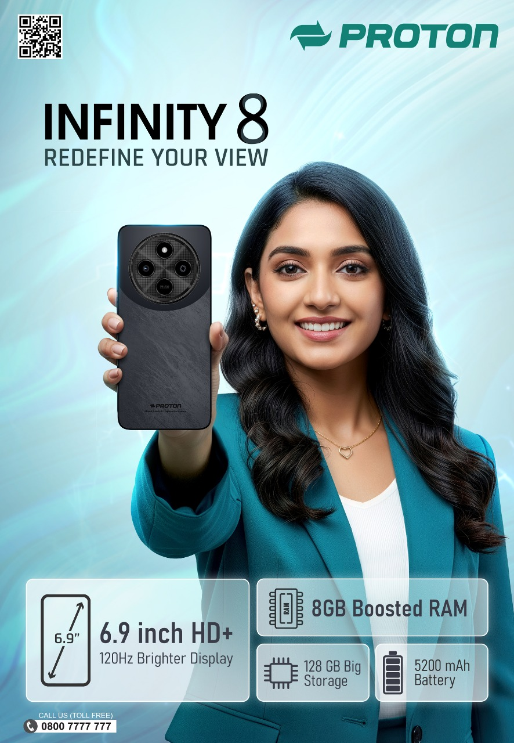
Smart Phone – Infinity 8
Features :
Display: 6.9 HD+ ,120 Hz , Cinematic IPS
Processor : Unisoc T606 , Octa Core
RAM: Boosted 8GB (4+4GB)
ROM: 128GB (Expandable Upto 1TB)
Rear Camera : 50MP
Front Camera: 13MP
Battery : 5200mAh
Sensors: Gravity, Proximity, Light,
Side-Mounted Fingerprint
OS : Android 15
Color : Black Velvet
Anti Collision bems , less chance for drop & Surface scratches for lasting Durability
Item Code – 751177
Item-Proton Smart Phone Infinity 8
MRP - 10499

Slide 4
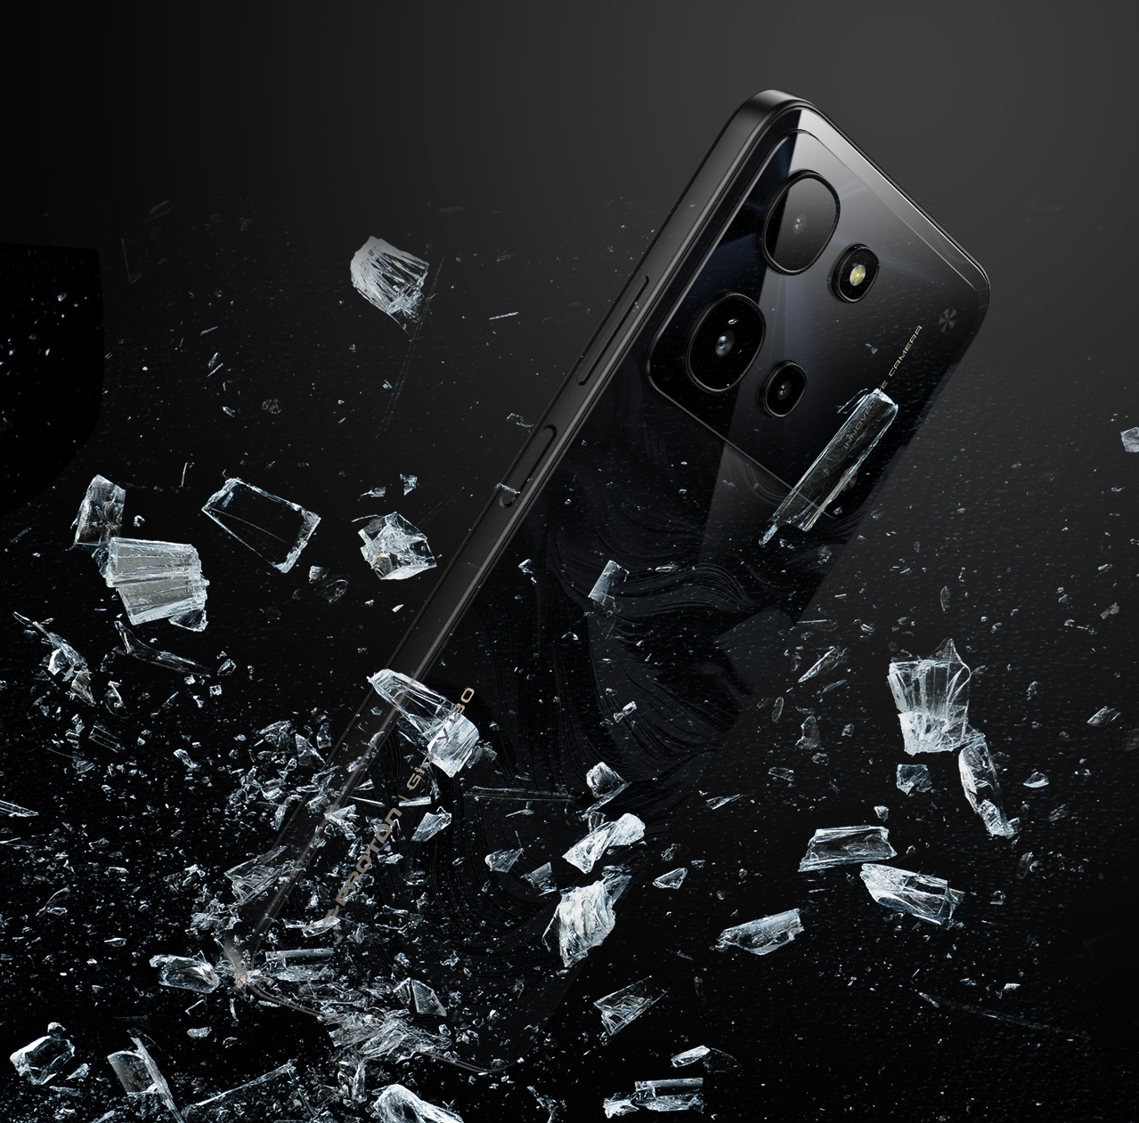
Nov
Smart Phone – Proton Glory i30
Features :
Processor : MTK G50
Display: 6.745 inch , Refresh Rate : 90Hz ,
RAM: 4GB (physical) + 8GB Boosted
ROM: 128GB
Rear Camera : 50MP(by SW) + VGA+VGA
Front Camera: 8MP(by SW)
Battery : 6000mAh
Sensors: Gravity, Proximity, Light,
Side-Mounted Fingerprint
OS : Android 15
Color : Dark Mirror ,Titanium Storm
IP 64 water proof
Dido OS based on Android 15

Slide 5
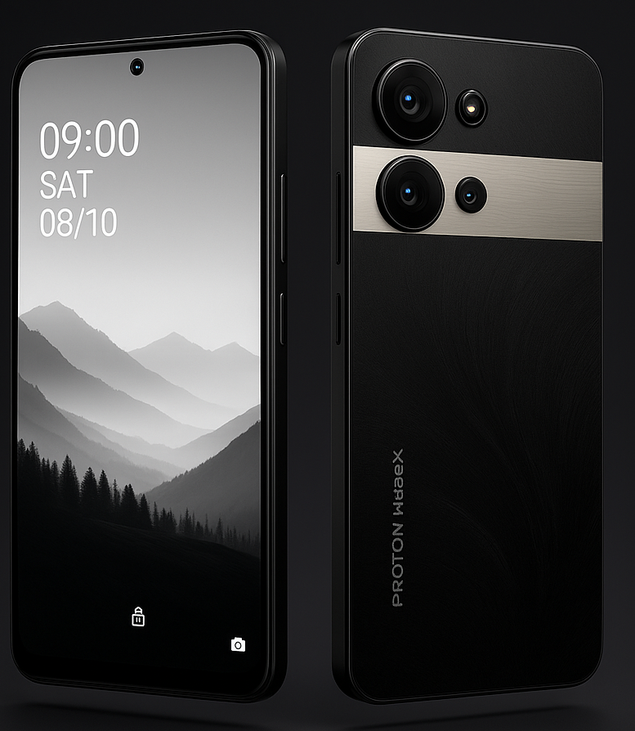
Smart Phone – HyperX
Dec
Features :
Display: 6.78 inch FHD+ ,2.5D ,120 HZ Smooth Visual
RAM: 16GB Boosted * RAM ( 8+8) ,
ROM: 128GB (Expandable Upto 1TB) UMCP Super High-Speed Memory
Rear Camera : 108MP AI Triple SONY Camera ,
EIS Video Anty Shake
Front Camera: 50M Selfie
Processor : MTK G100 Gaming Processor , Octa Core ,
2.2 GHz , 6 nm
Battery : Power Marathon 6000mAh Li-Polymer ( Supports 33W Fast Charging )
Sensors: Gravity, Proximity, Light,
Side-Mounted Fingerprint
OS : Android 16
Color : Black
Feel like Feather weight with 8.6mm Thikness
Sunshine Screen in Outdoor :700 + nits brightness
Splashproof, IP64 , Gorilla Glass , Dynamic Bar
Smart Control : Smartwake , Lift to Check Phone , Smart motion , Pocket Mode . Exclusive Default Call Recording Features . ( No notifications )

Slide 6
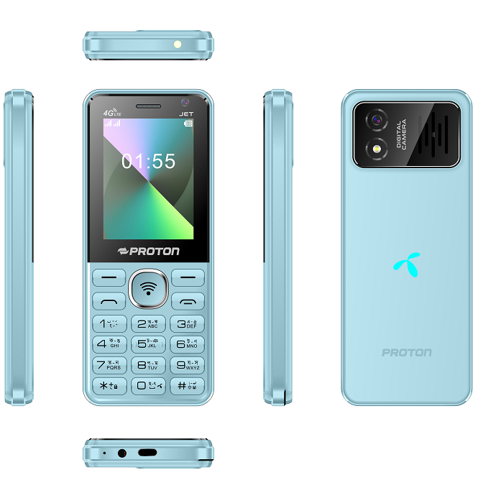
Nov
Proton JET 4G
Features :
GSM- B2/B3/B5/B8
LTE/FDD -B1/B3/B5/B8/B38/B40/B41
Dual SIM , Dual Standby
2.4-inch, Bright Color Display
Wireless FM Radio with Recording
Memory Card support
2000 mAh Li-ion Battery
MP3, MP4 , 3GP
Memory -64MB+128MB
CPU - T127
Automatic Call Recorder
Highlight Features :
4G LTE Phone with Front and Rear Camera
Wi-Fi
TikTok , YouTube , Shorts ,X( Twitter) ,Facebook , Wikipedia , MyGP
Type-C charging port
Slim PC Glass Finishing
MRP - BDT 2500

Slide 7
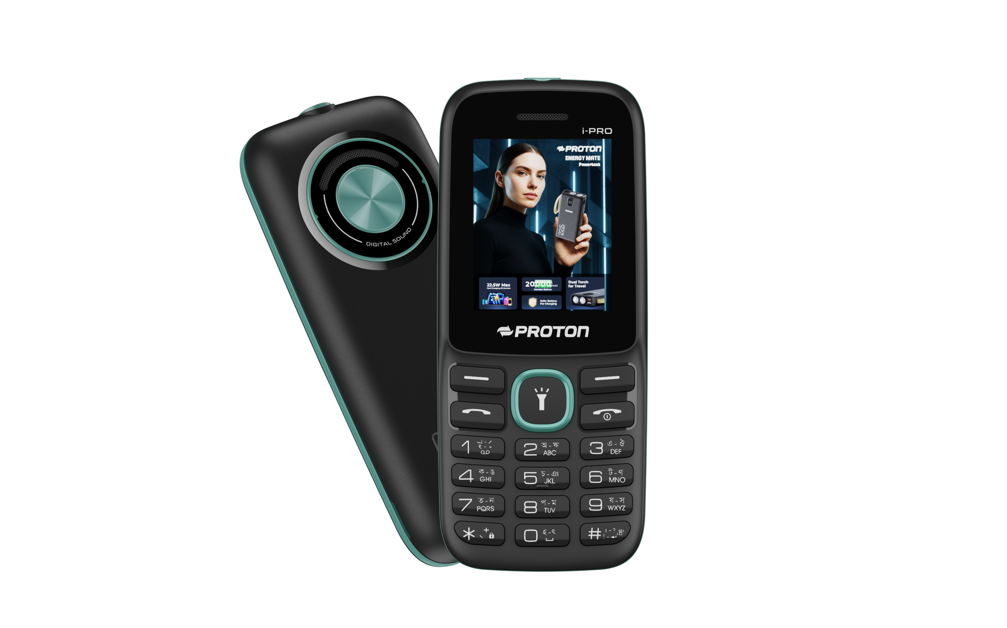
Oct
Proton i-Pro
Features :
Dual SIM (G+G) , Dual Standby
2 inch, QVGA Bright Color Display .
Wireless FM Radio with Recording
Memory Card support (Micro SD up to 32GB )
MP3, MP4 , 3GP
Compact and Stylish modern outlook
Automatic Call Recorder
Digital Camera
Highlight Features :
2 inch Big Display
1000 mAh Monster battery
Big Long Distance Torch
MTK Chipset
Robust Build
Type C Port
Color – Black Olive
Black Red
Black Blue

Slide 8
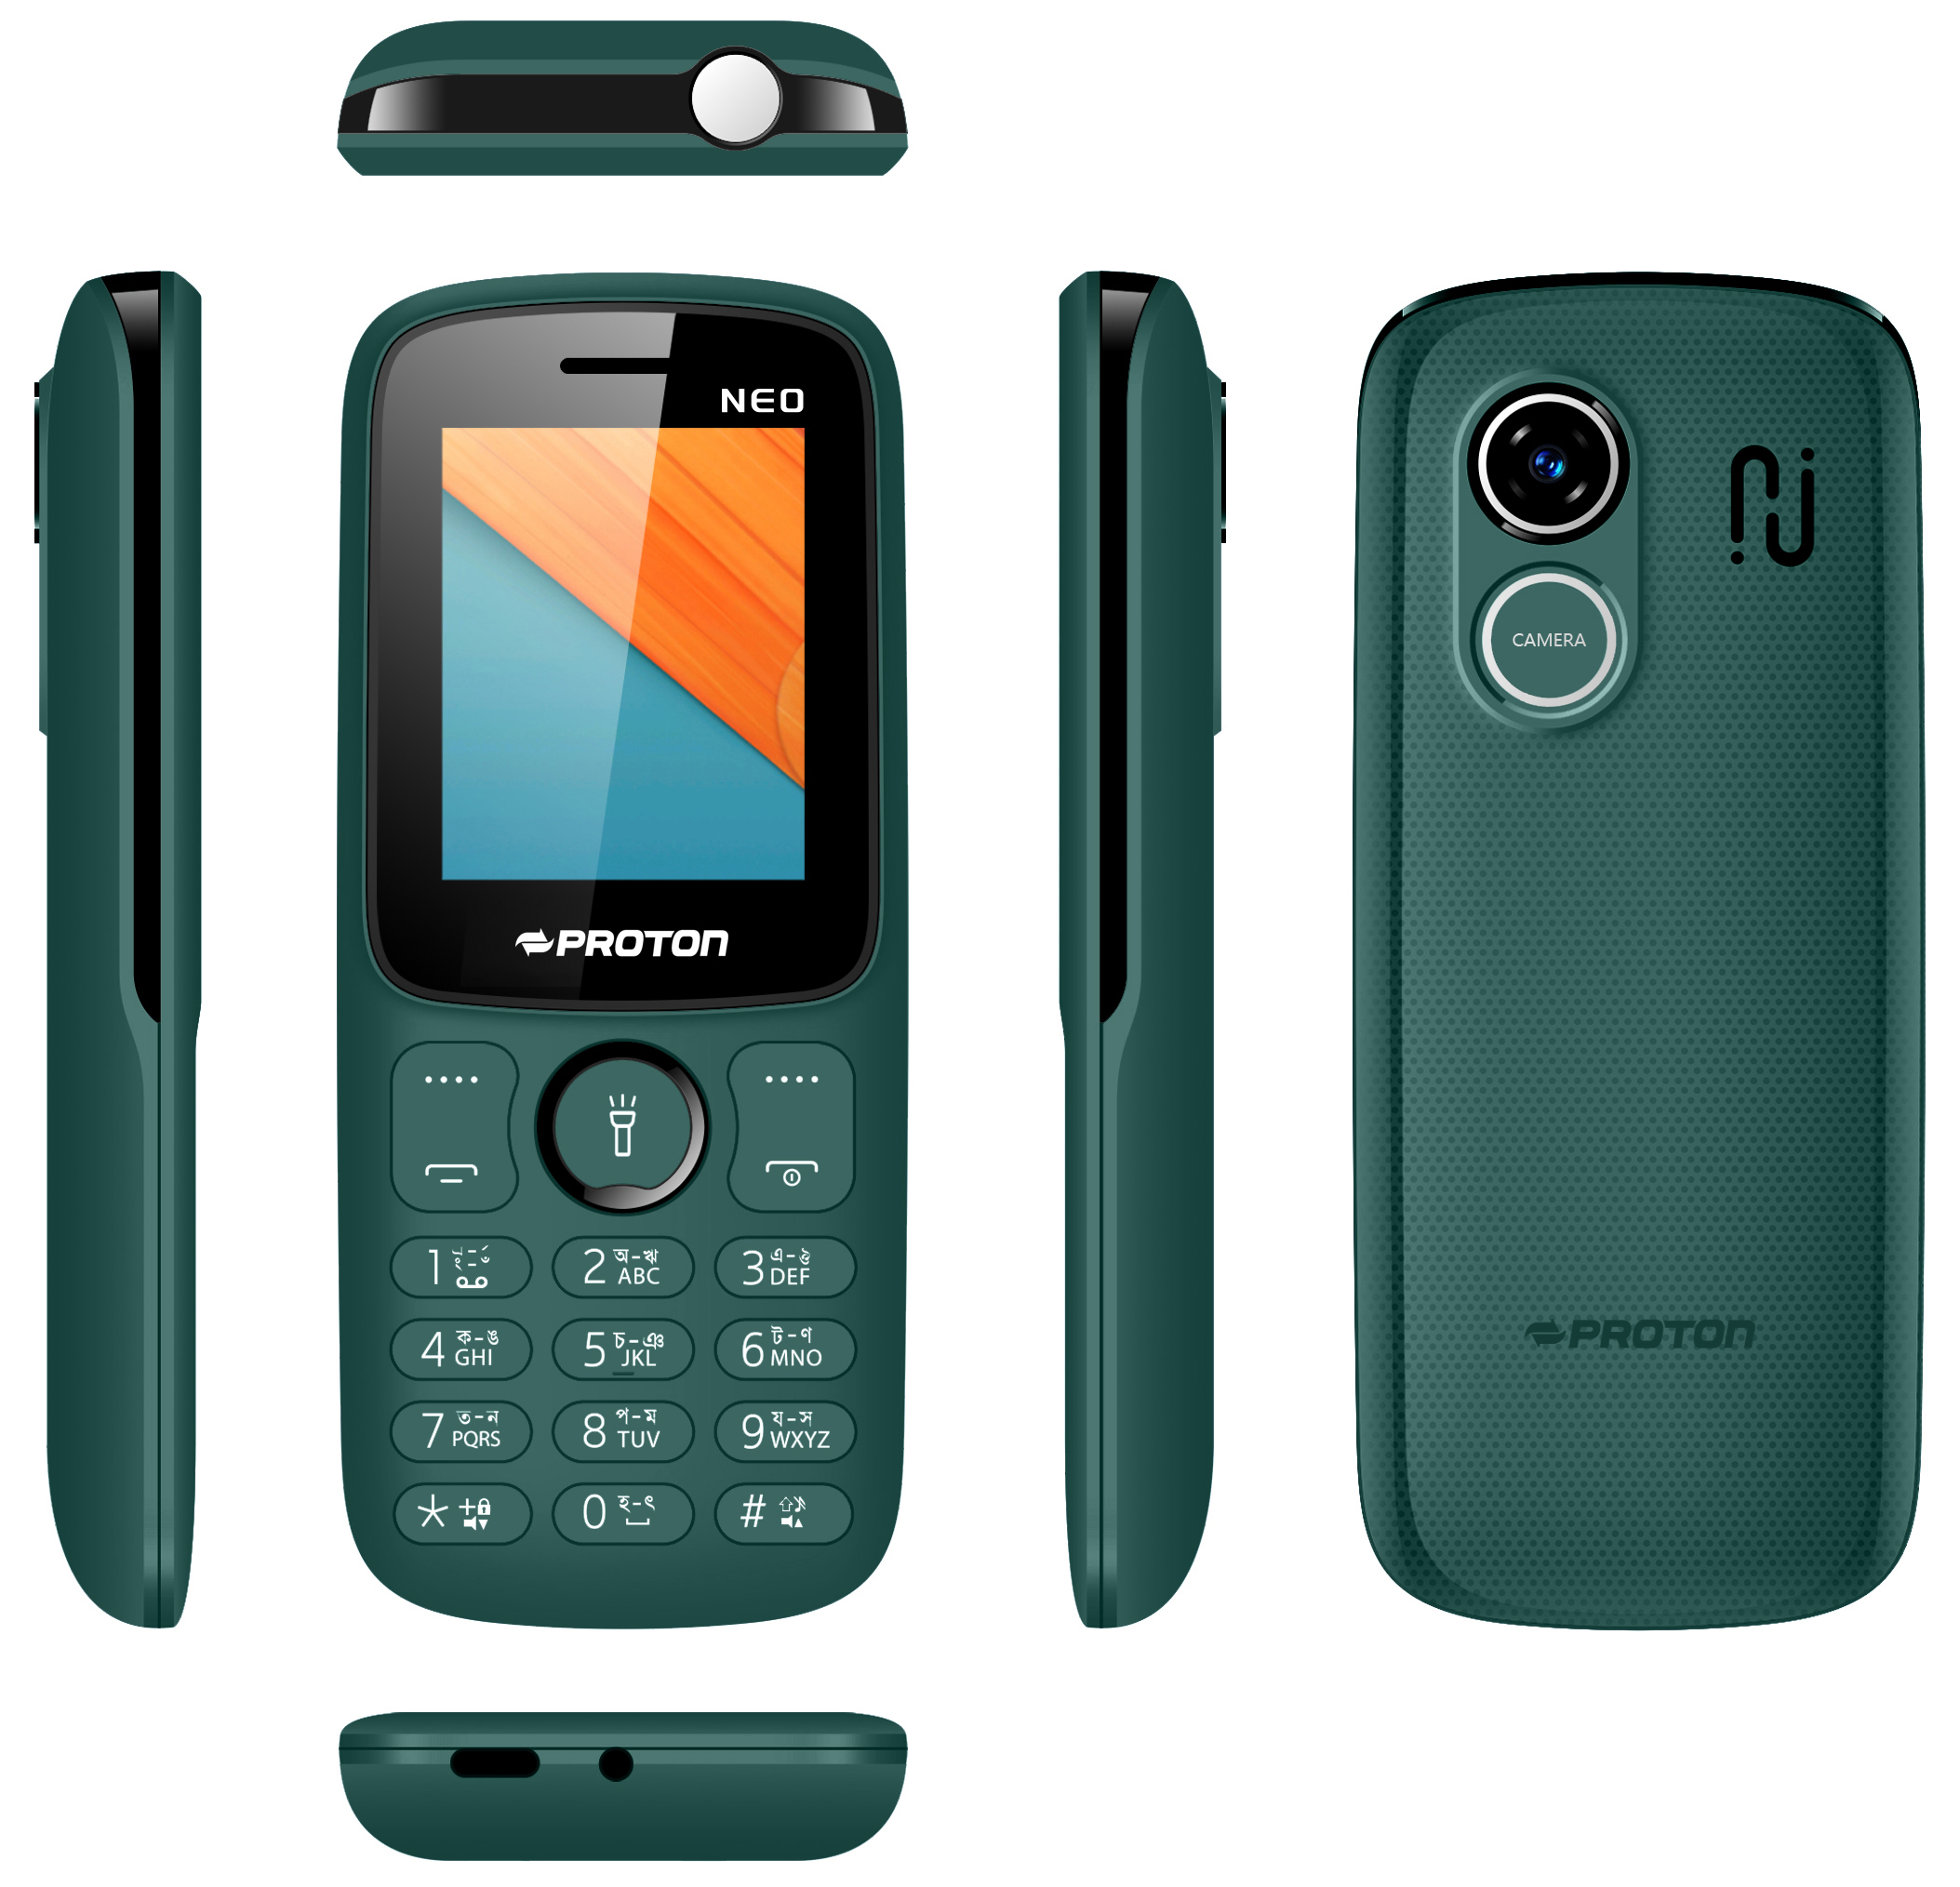
Oct
Proton NEO
Features :
Dual SIM (G+G) , Dual Standby
2 inch, QVGA Bright Color Display .
Wireless FM Radio with Recording
Memory Card support (Micro SD up to 32GB )
MP3, MP4 , 3GP
Compact and Stylish modern outlook
Automatic Call Recorder
Digital Camera
Highlight Features :
2 inch Big Display
2500 mAh Monster battery
Big Long Distance Torch
MTK Chipset
Robust Build
Type C Port
Color – Carbon Black
Ocean Wave
Forest Pine

Slide 9
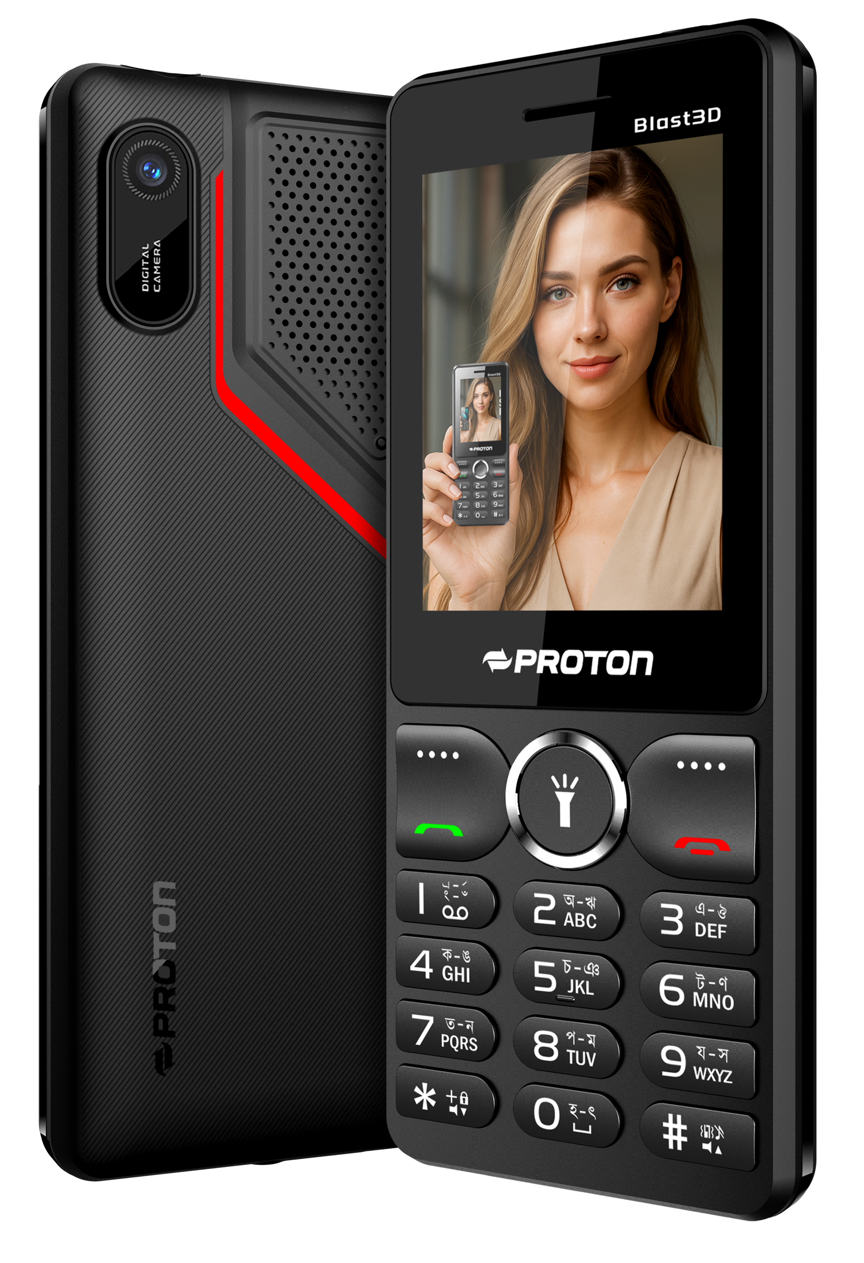
Nov
Proton Blast3D
Features :
Dual SIM (G+G) , Dual Standby
2.4 inch, QVGA Bright Color Display .
Wireless FM Radio with Recording
Memory Card support (Micro SD up to 32GB )
MP3, MP4 , 3GP
Compact and Stylish modern outlook
Automatic Call Recorder
Digital Camera
Highlight Features :
2.4 inch Big Display
3D Loud Speaker
Digital Camera
3000 mAh Monster battery
Big Long Distance Torch
MTK Chipset
Robust Build
Type C Port
Color –

Slide 10
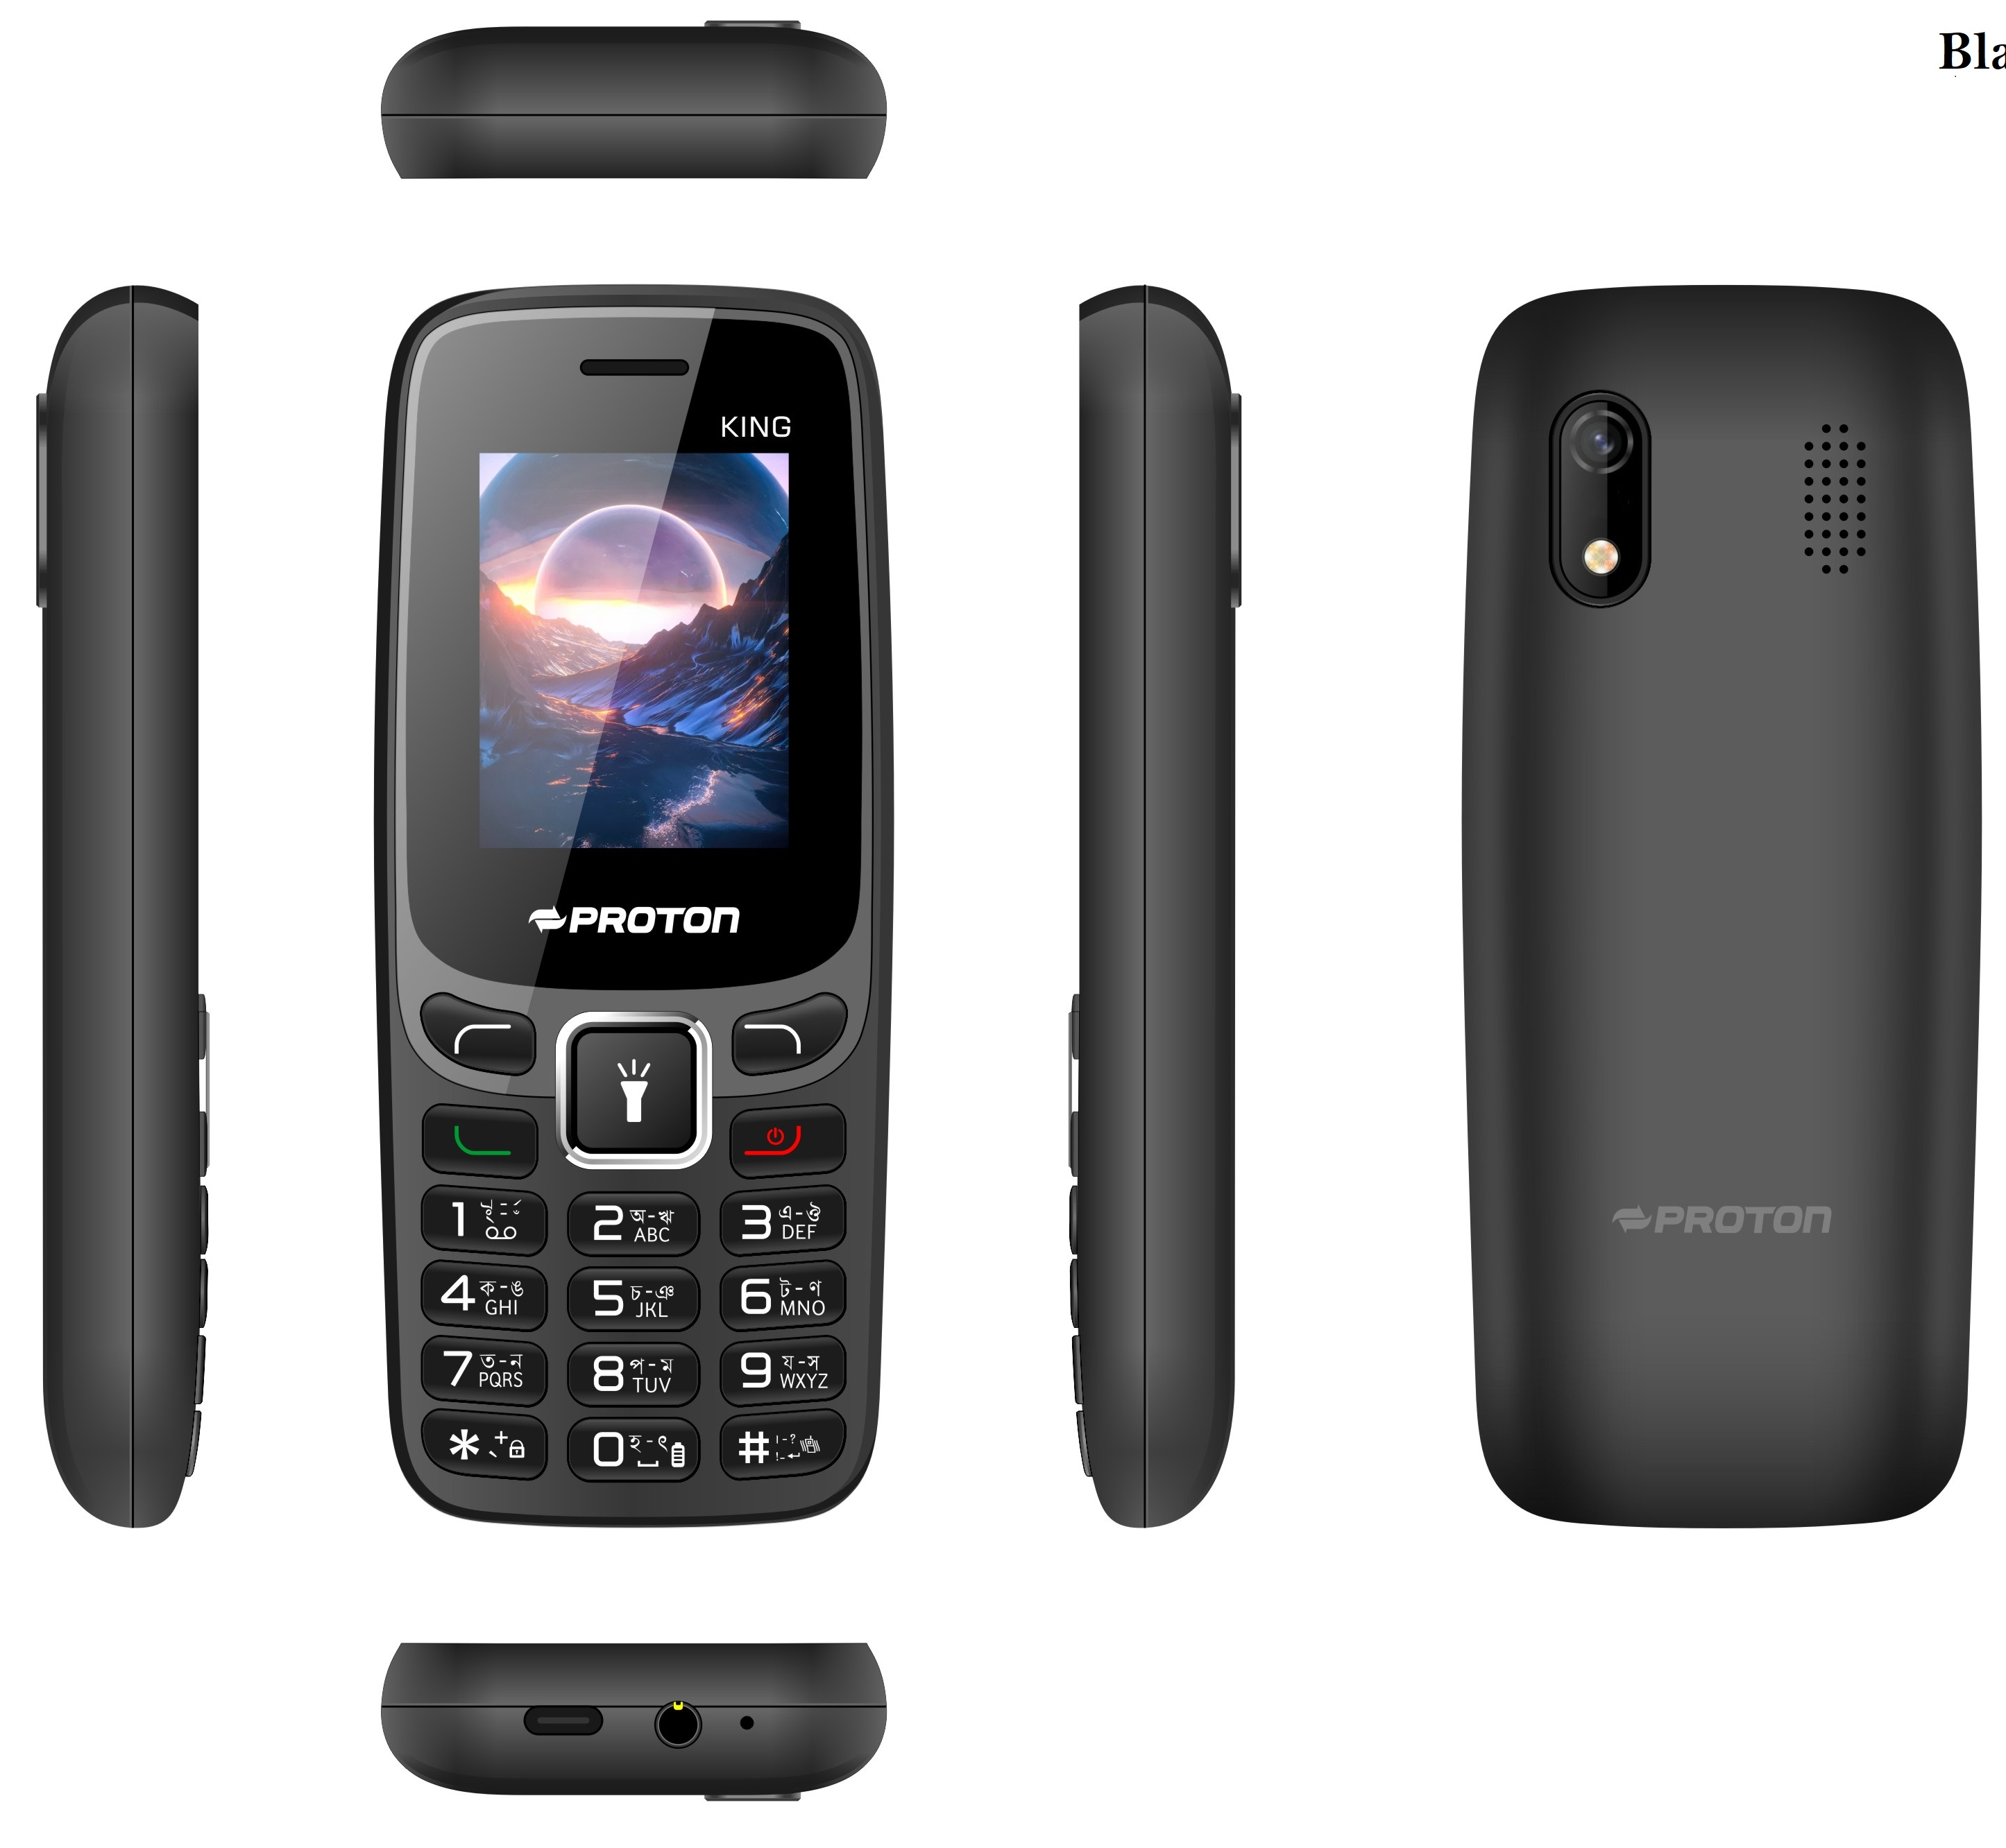
Nov
Proton King
Features :
Dual SIM (G+G) , Dual Standby
1.77 inch, QVGA Bright Color Display .
Wireless FM Radio with Recording
Memory Card support (Micro SD up to 32GB )
MP3, MP4 , 3GP
Compact and Stylish modern outlook
Automatic Call Recorder
Digital Camera
Highlight Features :
1.77 inch Big Display
1000 mAh battery
Digital Camera
Robust Build
Color – Black
Cyan
Blue

Slide 11
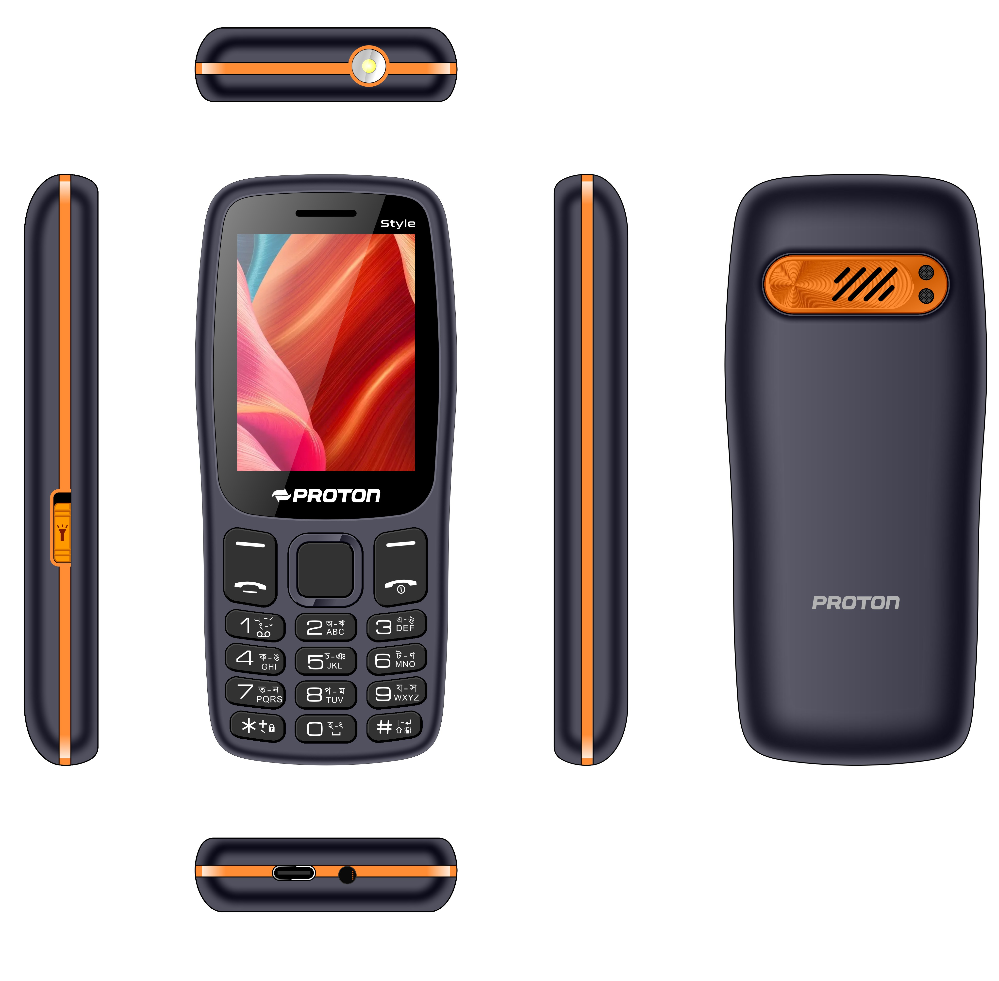
Nov
Proton Style
Features :
Dual SIM (G+G) , Dual Standby
2.4 inch, QVGA Bright Color Display .
Wireless FM Radio with Recording
Memory Card support (Micro SD up to 32GB )
MP3, MP4 , 3GP
Compact and Stylish modern outlook
Automatic Call Recorder
Highlight Features :
2.4 inch Big Display
3000 mAh Monster battery
Big Long Distance Torch
MTK Chipset
Robust Build
Type C Port
Color –

Slide 12
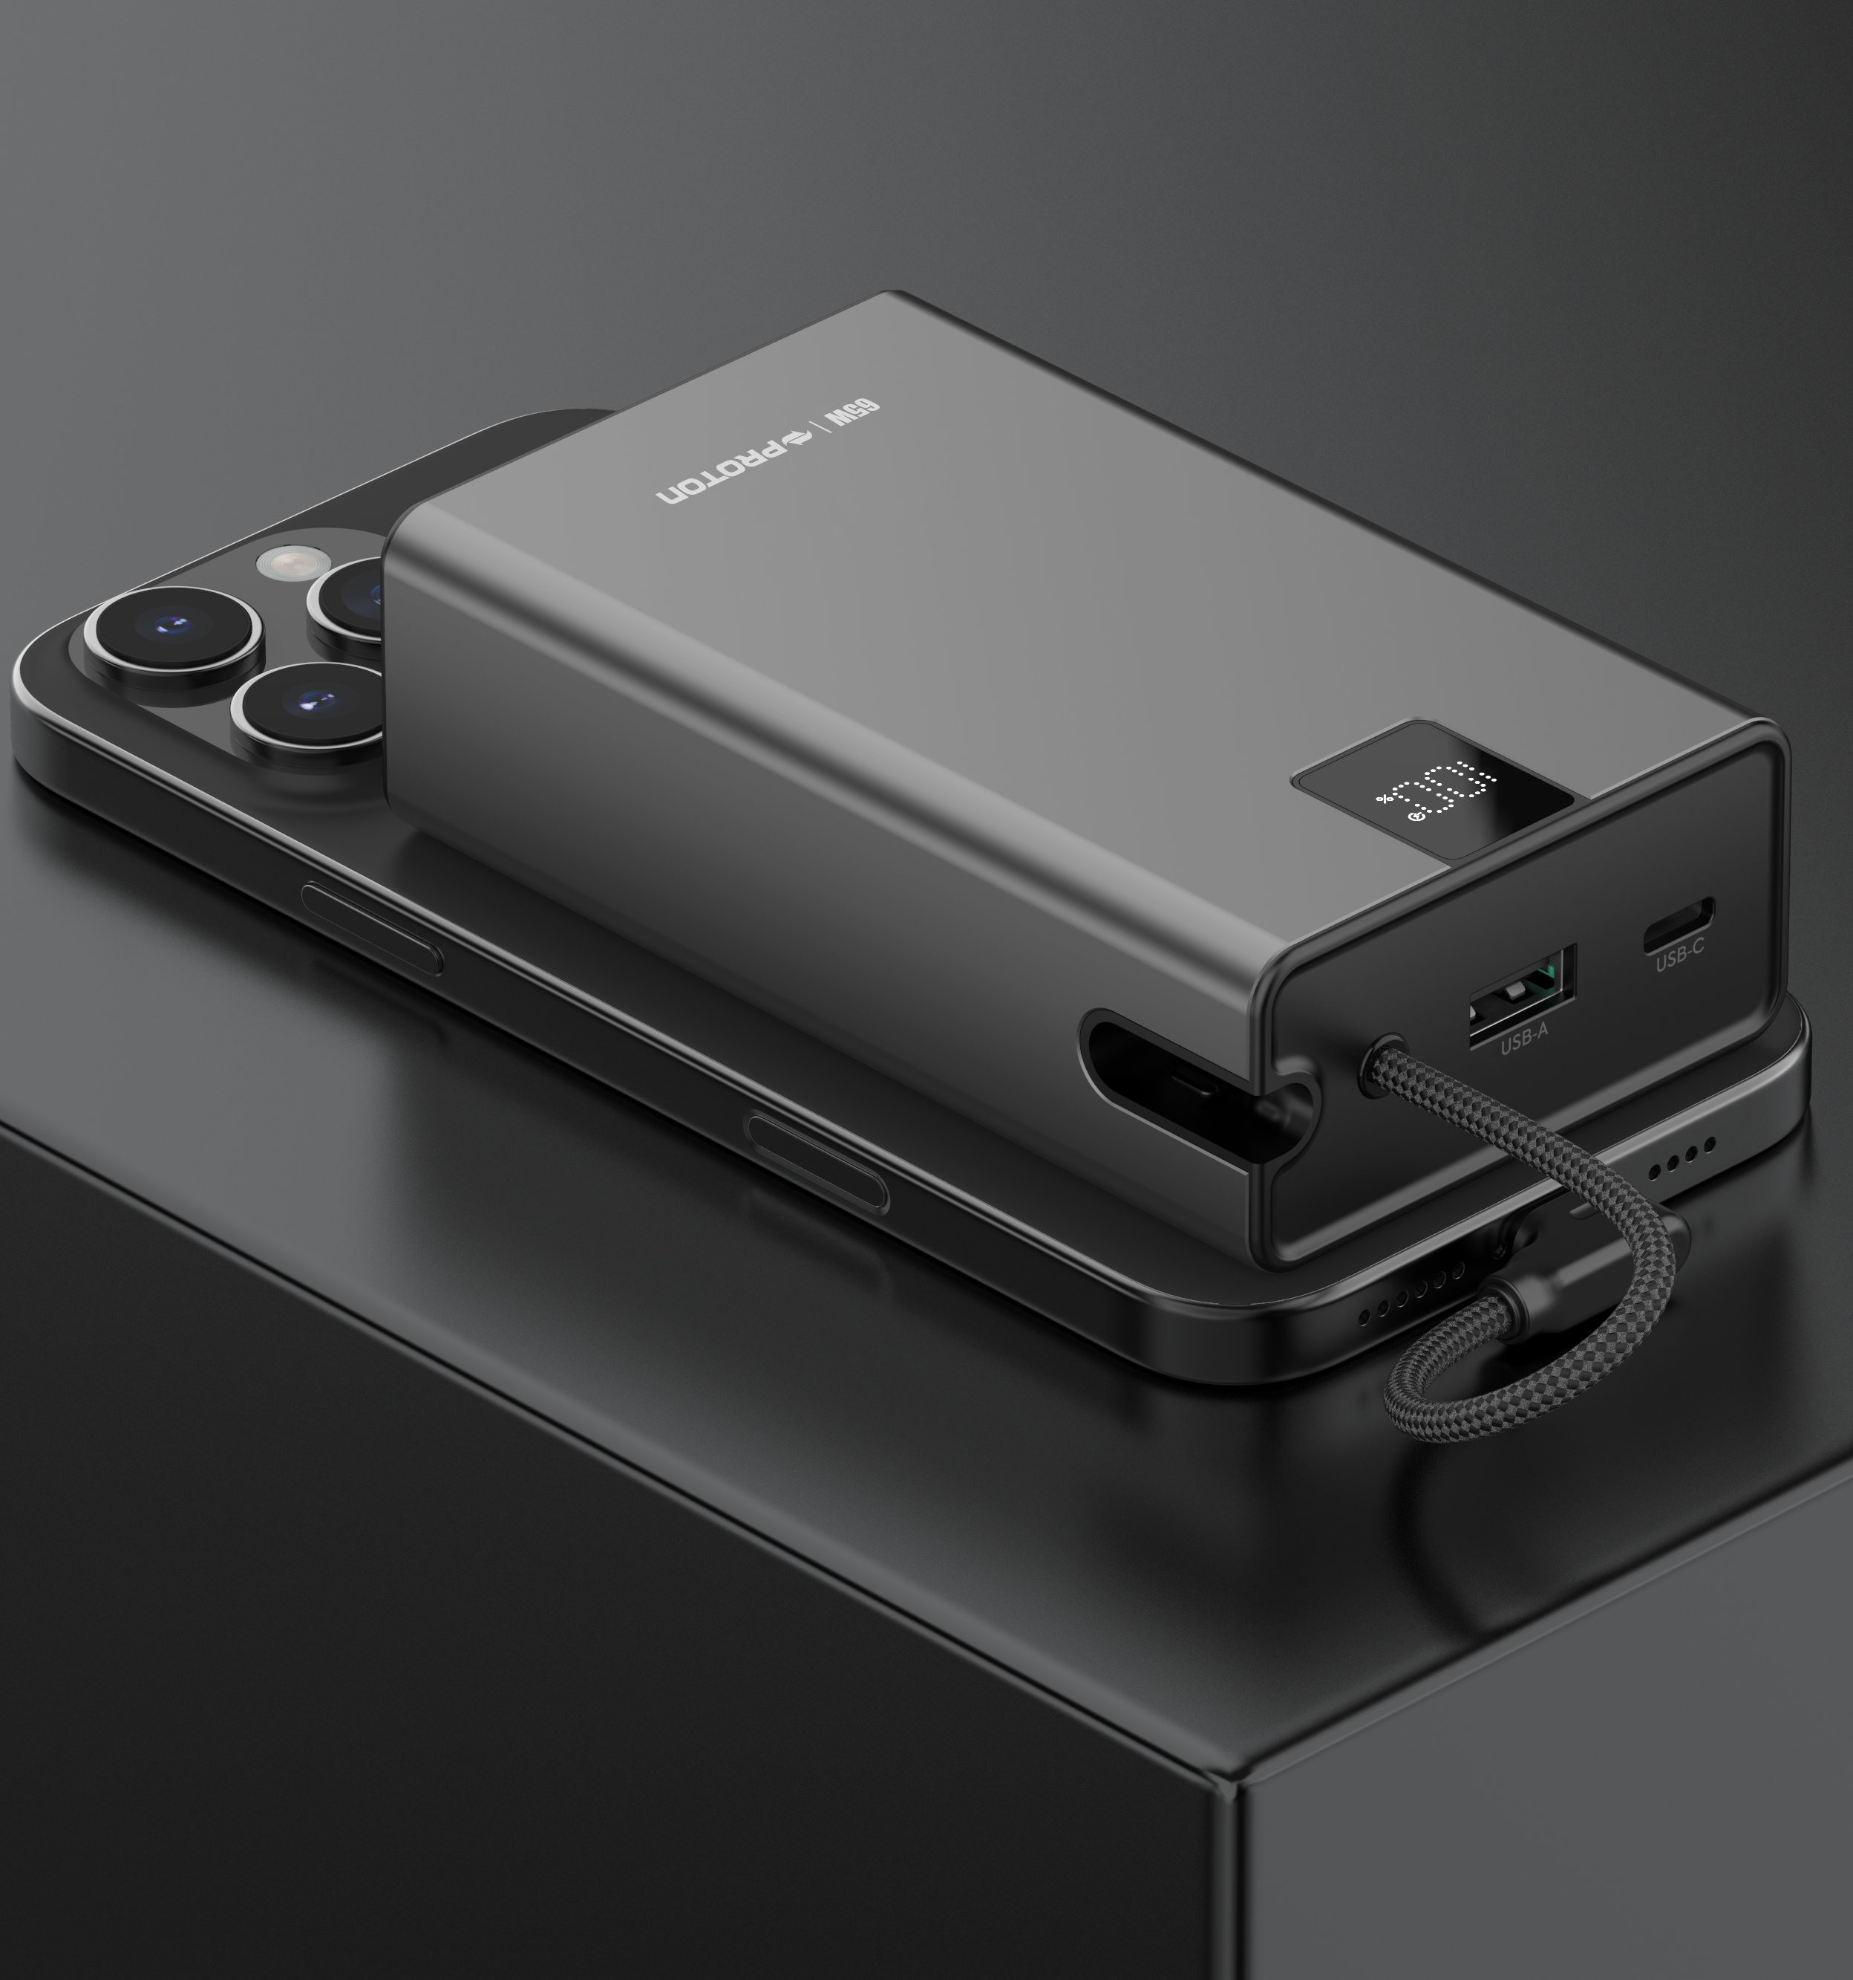
Oct
Proton Power Bank- Spark 65+
Proton Power Bank- Spark 65+
Features :
PD65W Laptop Power Bank
-With built-in type-c cable as lanyard.
-Support Iphone 15/16,etc.
Material: Aluminum Alloy
Capacity: 20000mAh
Battery:706074*4
Type-C input&output :5V3A/9V3A/12V3A/15V3A/20V3.25A（PD65W）
Type-C cable input:5V3A/9V3A/12V3A/15V3A/20V3.0A（PD60W）
Type-C cable output:5V3A/9V3A/12V3A/15V3A/20V3.0A/10V2.25A（PD60W)SCP
USB-A output:5V3A/9V2.22A/10V/2.25A/12V1.67A（22.5W）
Multi-port ouput at the same time:5V2A
Dimension: 110*65*32.6mm
N.W.:372g
Item Code –
Item - Proton Power Bank- Spark 65+
MRP -

Slide 13
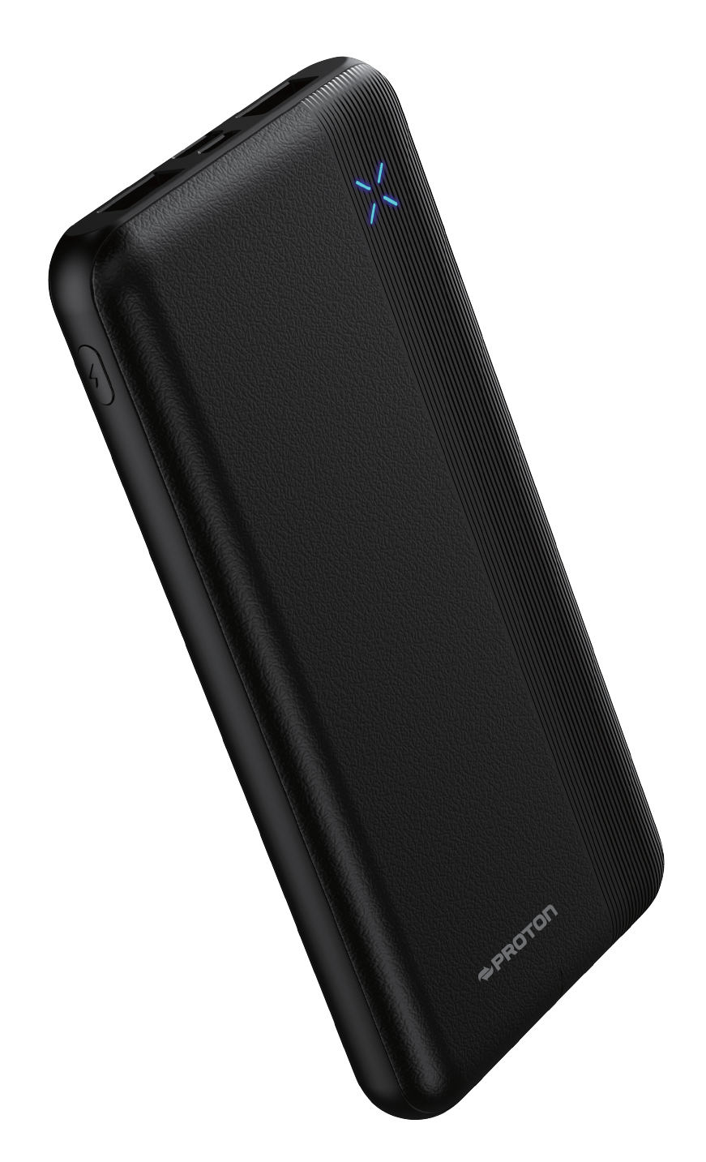
Proton POWER BANK Energy Mate10- 10000mAh
Oct
Features :
Model: Energy Mate-10
Material: ABS
Capacity: 10000mAh
Input: 5V/2A
Output: 5V/2A
Dimension: 38*70.4*15.9mm
Item Code –
Item - Proton Power Bank- EnergyMate-10
MRP -

Slide 14
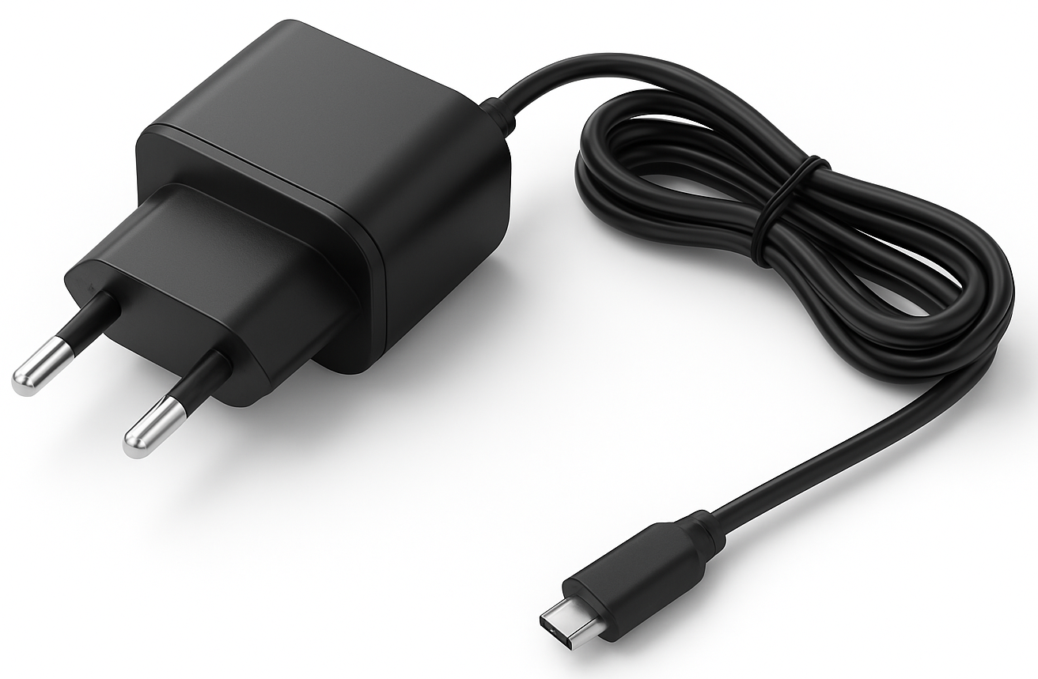
Oct
7V FAST CHARGER- B01-7V
Features:
Input : 100-240V , 50-60Hz
Output : 15W
Plug Standard: EU
Overvoltage & Overcurrent Protection
Short Circuit Protection
Item Code –
Item - Proton Mobile Charger RE-B01-7V
MRP -

Slide 15
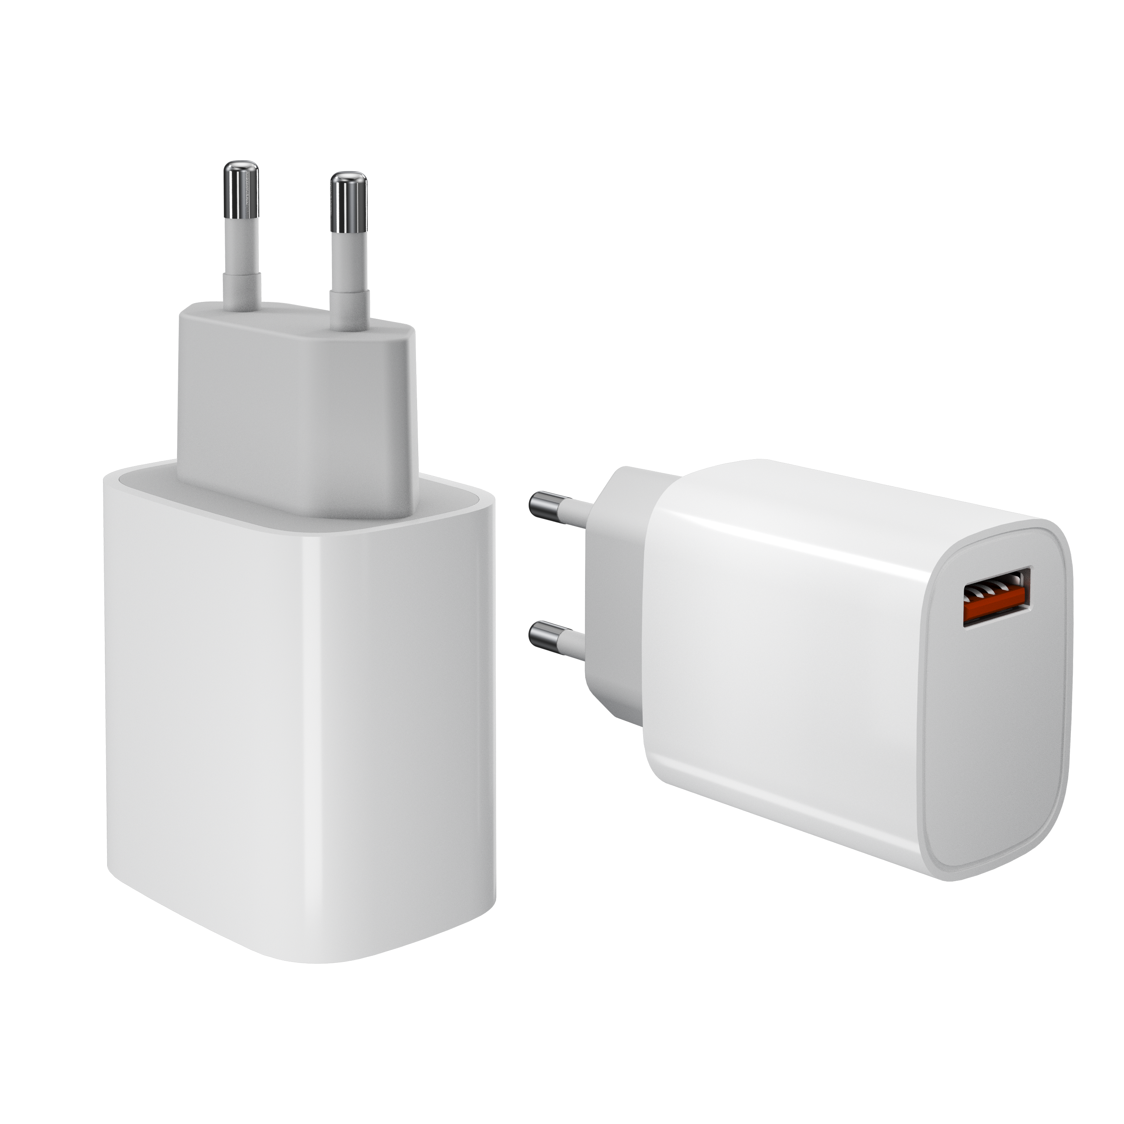
Oct
15W FAST CHARGER- S15W
Features:
Input : 100-240V , 50-60Hz
Output : 15W
Plug Standard: EU
Overvoltage & Overcurrent Protection
Short Circuit Protection
Item Code –
Item - Proton Mobile Charger RE-S15W
MRP -

Slide 16
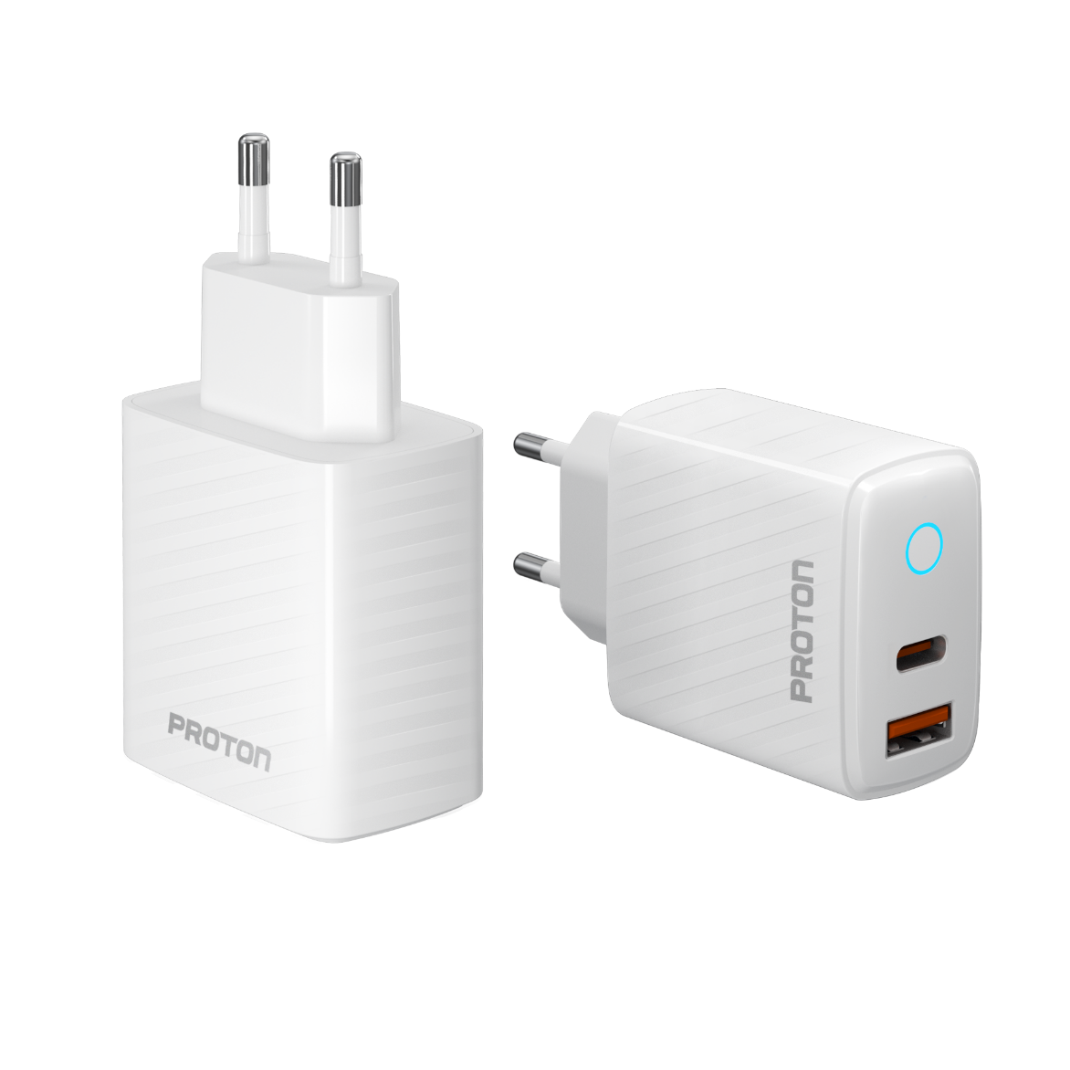
Oct
20W FAST CHARGER- T20 Ultra
Features:
Input : 100-240V , 50-60Hz
Output : 5V/3A, 9V/2.22A, 12V/1.67ª
Plug Standard: EU
Dual Port ( A +C)
LED Light
Overvoltage & Overcurrent Protection
Short Circuit Protection
Item Code –
Item - Proton Mobile Charger RE- T20 Ultra
MRP -

Slide 17
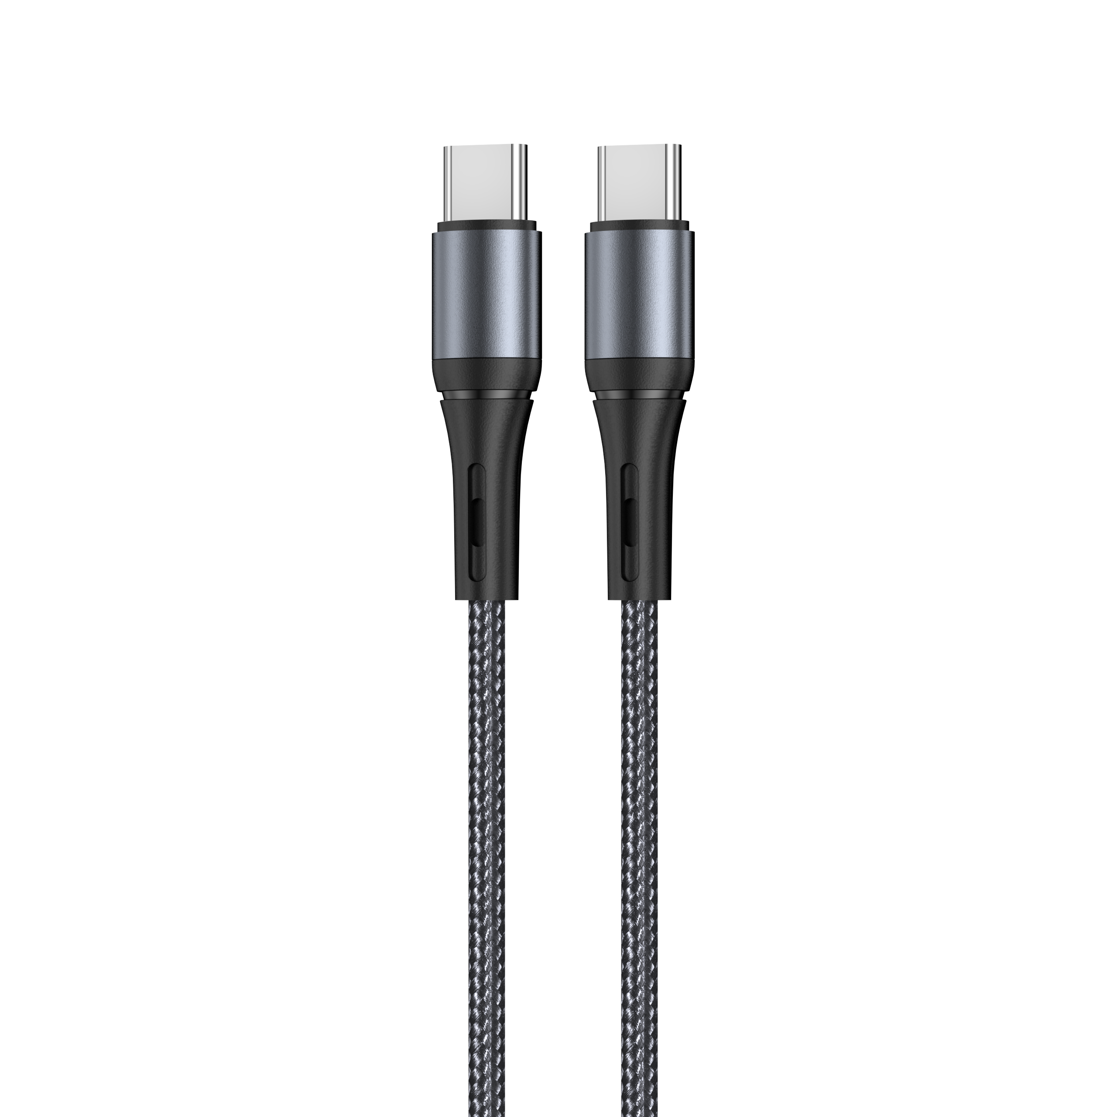
Oct
Proton Fast Charging-USB Cable-C-C ( 67W) 1M
Nylon Braided Cable 65W
Features:
1. Coat Material: woven cotton
2. USB Material: Alluminum Alloy
3. Conductor: 60/0.08*2C+16/0.08*3C Pure Copper Wire
4. Cable Ture Current: 3A
5. OD: 4.0mm
6. Function: Charging & Data Transfer
7.Data Transfer Speed: 480Mbps
8. Tensile Resistance: ≤30kgs
9.Length: 1M
10. LED Function
11. 65W PD
12. 35,000 Bend Lifespan
Multiple security protection, non-damage fast charging and real- time fast data synchronization.
Upgraded and strengthened interface can withstand repeated bending or buckling to avoid breakage.
Using environment friendly materials which are soft, elastic, anti-pulling and anti-bending
Item Code – 751098
Item - Proton Fast Charging-USB Cable-C-C ( 67W) 1M
MRP -

Slide 18
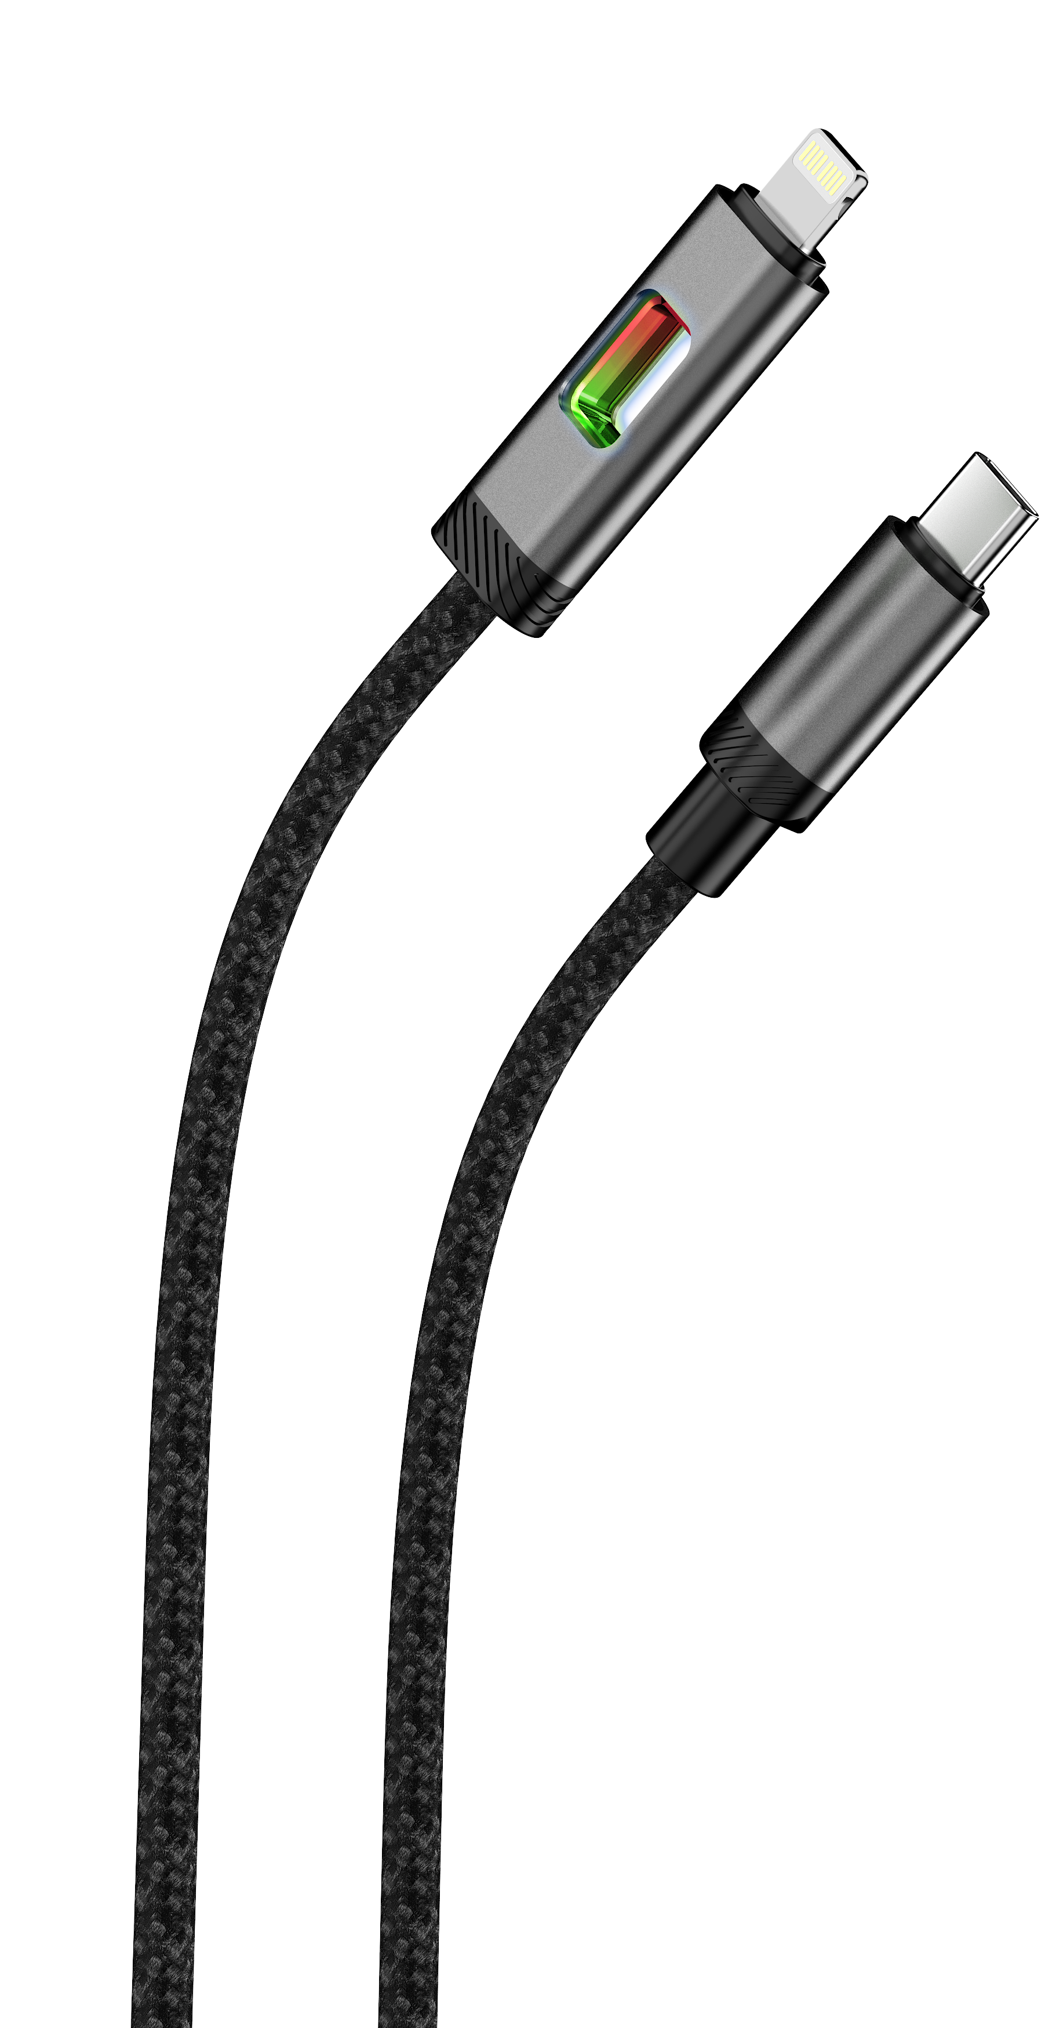
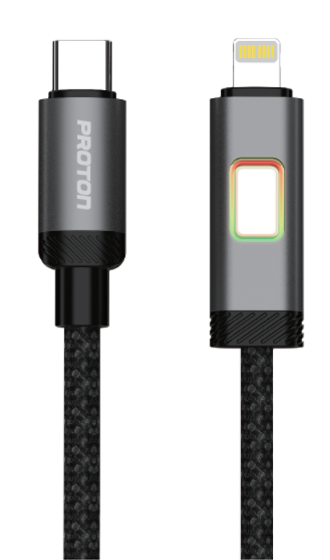
Oct
Proton Fast Charging-USB Cable-Spark C to L- LED 1M
Nylon Braided LED Cable 27W
Features:
1. Coat Material: woven cotton
2. USB Material: Alluminum Alloy
3. Conductor: 60/0.08*2C+16/0.08*3C Pure Copper Wire
4. Cable Ture Current: 3A
5. OD: 4.0mm
6. Function: Charging & Data Transfer
7.Data Transfer Speed: 480Mbps
8. Tensile Resistance: ≤30kgs
9.Length: 1M
10. LED Function
11. 27W PD
12. 35,000 Bend Lifespan
Multiple security protection, non-damage fast charging and real- time fast data synchronization.
Upgraded and strengthened interface can withstand repeated bending or buckling to avoid breakage.
Using environment friendly materials which are soft, elastic, anti-pulling and anti-bending
Item Code –
Item - Proton Fast Charging-USB Cable-Spark C to L- LED 1M
MRP -

Slide 19
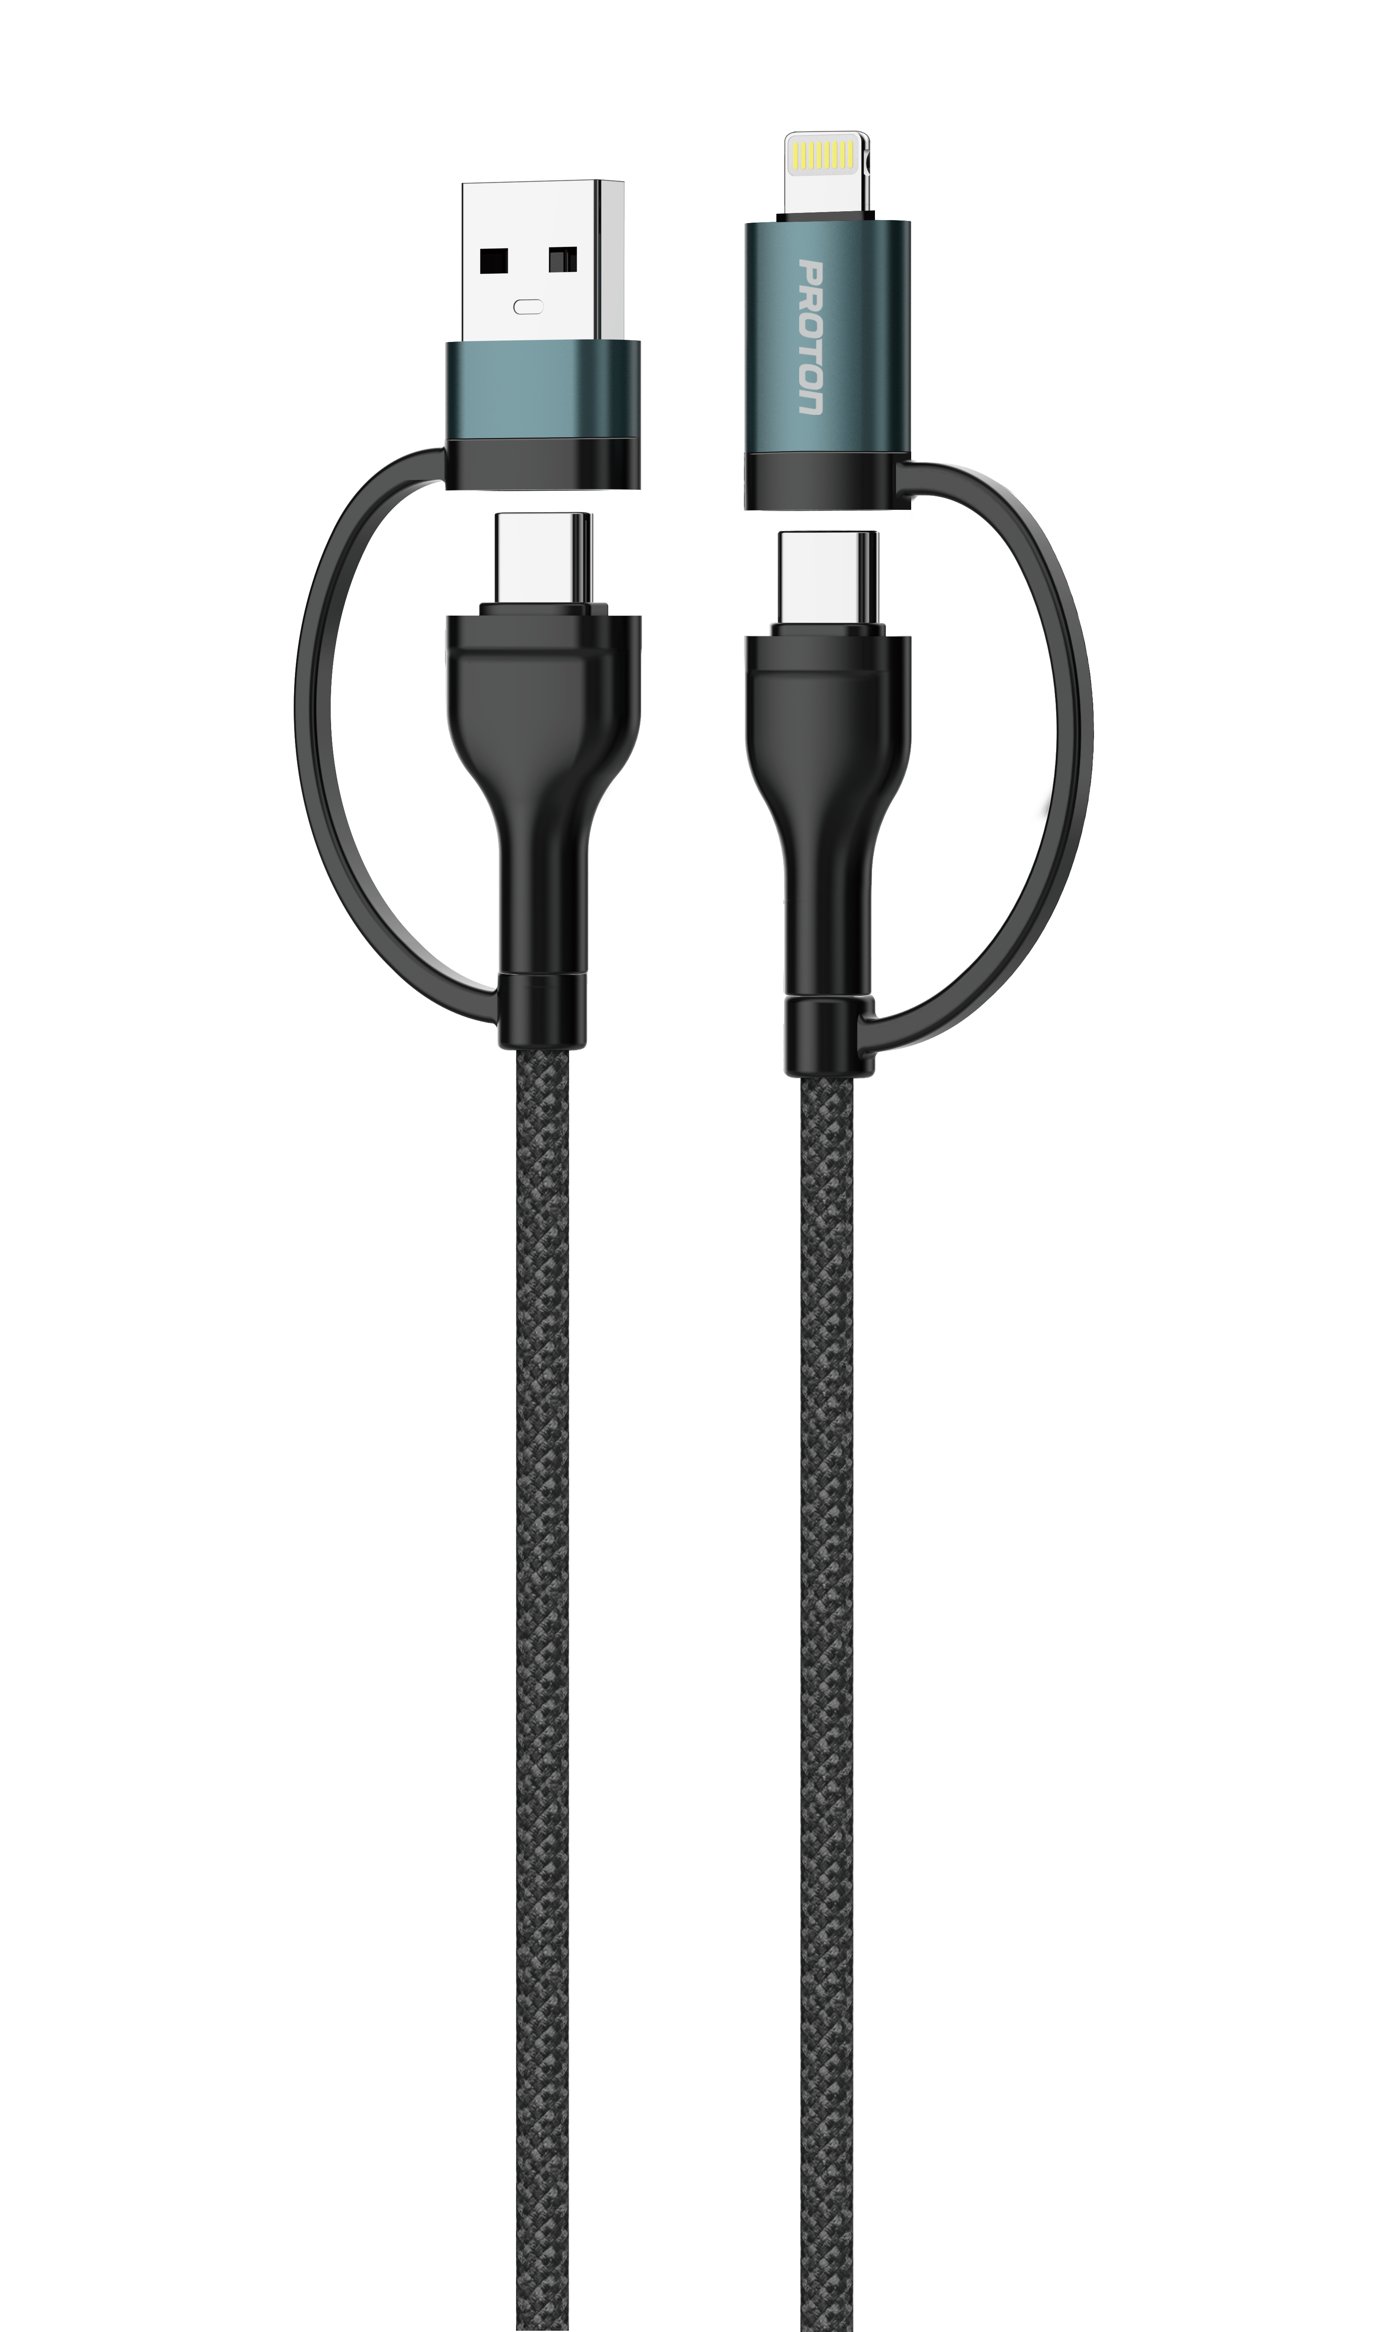
Oct
Proton Fast Charging-USB Cable-Spark- 4 IN 1
Nylon Braided 4in1 Cable 27W/60W
Features:
1. Coat Material: woven cotton
2. USB Material: Alluminum Alloy
3. Conductor: 60/0.08*2C+16/0.08*3C Pure Copper Wire
4. Cable Ture Current: 3A
5. OD: 4.0mm
6. Function: Charging & Data Transfer
7.Data Transfer Speed: 480Mbps
8. Tensile Resistance: ≤30kgs
9.Length: 1M
10. 35,000 Bend Lifespan
11. 27W / 60W
12. A to C /A to L / C to C / C to L
C TO C 60W
C TO L 27W
A TO C 5V 3A 15W
A TO L 5V 2.4A 12W
Item Code –
Item - Proton Fast Charging-USB Cable-Spark- 4 IN 1
MRP -

Slide 20
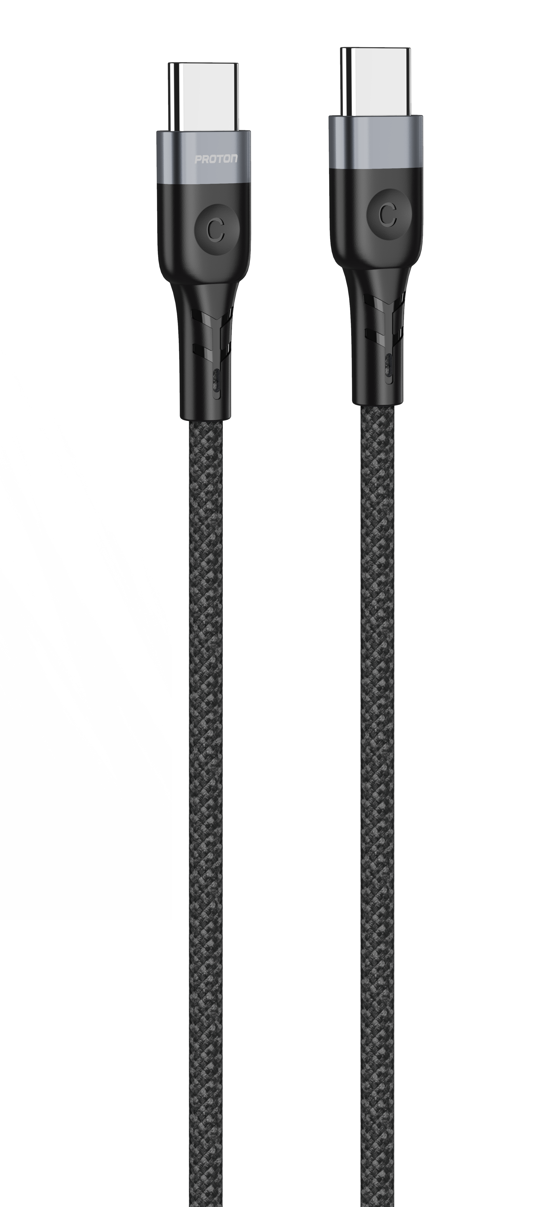
Oct
Proton Fast Charging-USB Cable Spark C-C -1M
Nylon Braided C TO C 60W
Features:
1. Coat Material: woven cotton
2. USB Material: Alluminum Alloy
3. Conductor: 60/0.08*2C+16/0.08*3C Pure Copper Wire
4. OD: 4.0mm
6. Function: Charging & Data Transfer
7.Data Transfer Speed: 480Mbps
8. Tensile Resistance: ≤30kgs
9.Length:1M
10. 35,000 Bend Lifespan
11. 60W PD
12. Type C to Type C
Item Code –
Item - Proton Fast Charging-USB Cable-Spark C-C-1M
MRP -

Slide 21
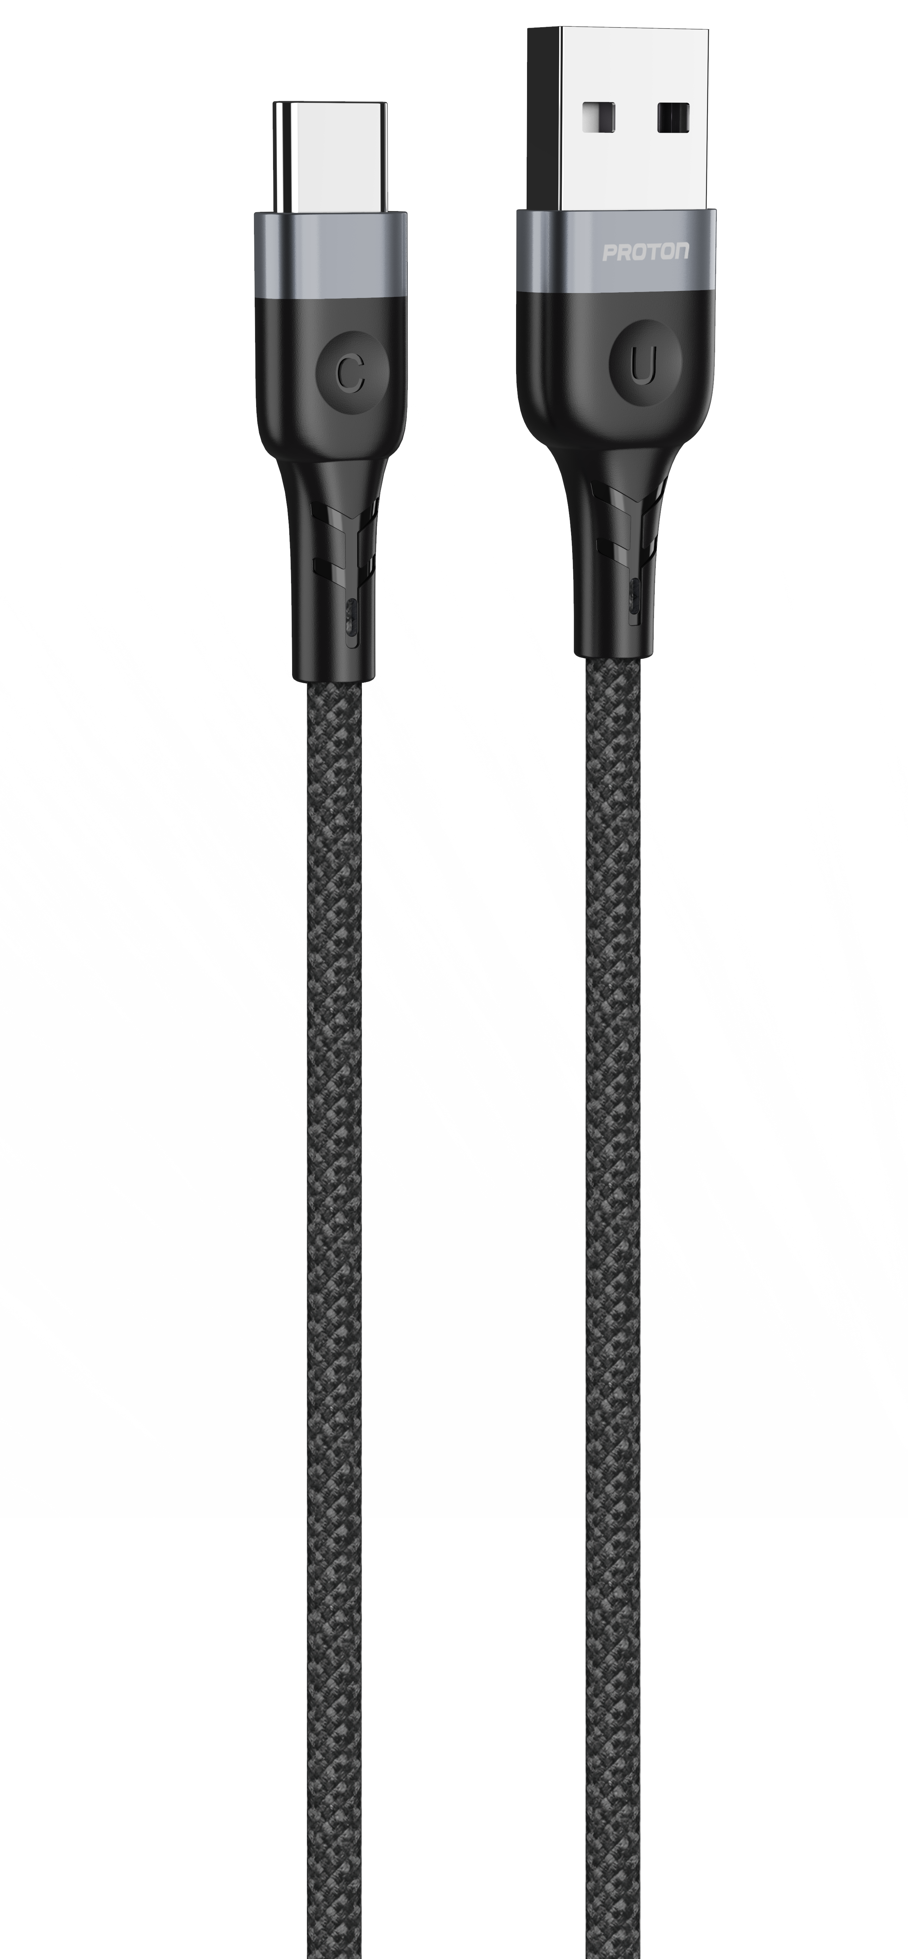
Oct
Proton Fast Charging-USB Cable Spark A-C -1M
Nylon Braided 3A Cable
Features:
1. Coat Material: woven cotton
2. USB Material: Alluminum Alloy
3. Conductor: 60/0.08*2C+16/0.08*3C Pure Copper Wire
4. Cable Ture Current: 3A
5. OD: 4.0mm
6. Function: Charging & Data Transfer
7.Data Transfer Speed: 480Mbps
8. Tensile Resistance: ≤30kgs
9.Length:1M
10. 35,000 Bend Lifespan
Item Code –
Item - Proton Fast Charging-USB Cable-Spark A-C-1M
MRP -

Slide 22
Oct
Proton Fast Charging-USB Cable Spark A-C -2M
Nylon Braided 3A Cable
Features:
1. Coat Material: woven cotton
2. USB Material: Alluminum Alloy
3. Conductor: 60/0.08*2C+16/0.08*3C Pure Copper Wire
4. Cable Ture Current: 3A
5. OD: 4.0mm
6. Function: Charging & Data Transfer
7.Data Transfer Speed: 480Mbps
8. Tensile Resistance: ≤30kgs
9.Length:1M
10. 20000+ Bending Test
Item Code –
Item - Proton Fast Charging-USB Cable-Spark A-C-2M
MRP -

Slide 23
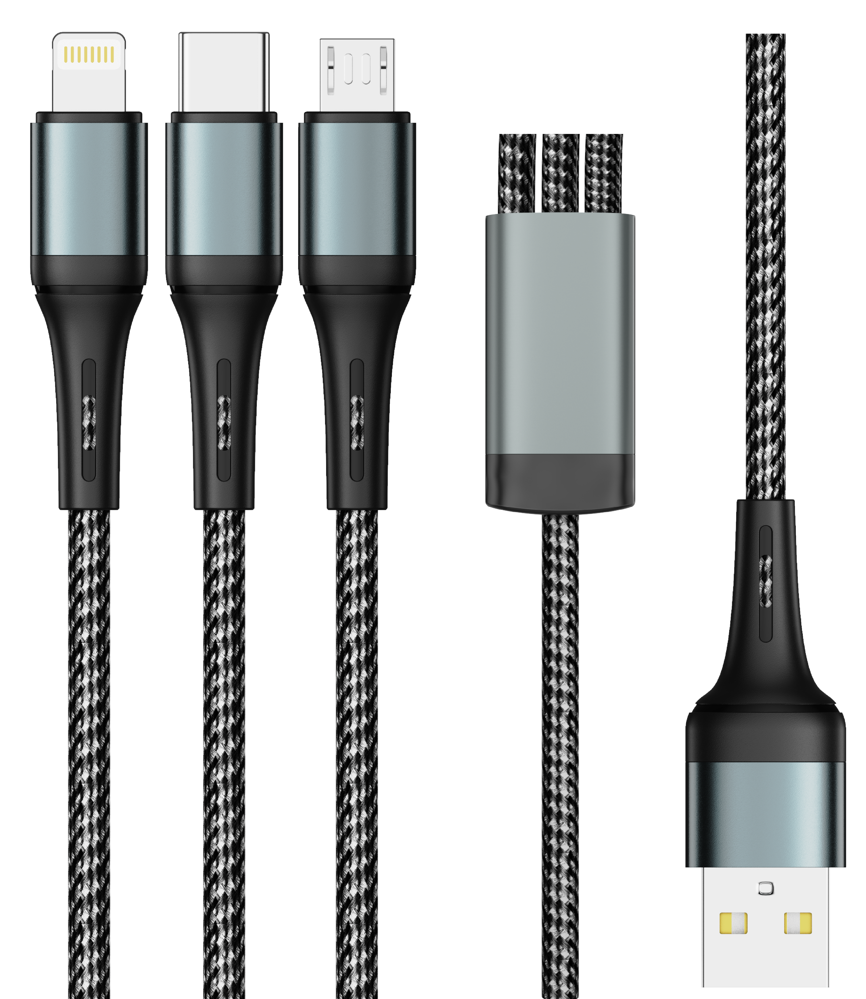
Oct
Proton Fast Charging-USB Cable-Spark- 3 IN 1
Nylon Braided USB 3in1 Cable
Features:
1. Coat Material: woven cotton
2. USB Material: Alluminum Alloy
3. Conductor: 50/0.08*2C+16/0.08*2C Pure Copper Wire
4. Cable Ture Current: 2.4A
5. OD: 4.0mm
6. Function: Charging & Data Transfer
7.Data Transfer Speed: 480Mbps
8. Tensile Resistance: ≤30kgs
9.Length: 1.2M
10. 35,000 Bend Lifespan
C TO C 60W
C TO L 27W
A TO C 5V 3A 15W
A TO L 5V 2.4A 12W
Item Code –
Item - Proton Fast Charging-USB Cable-Spark- 3 IN 1
MRP -

Slide 24
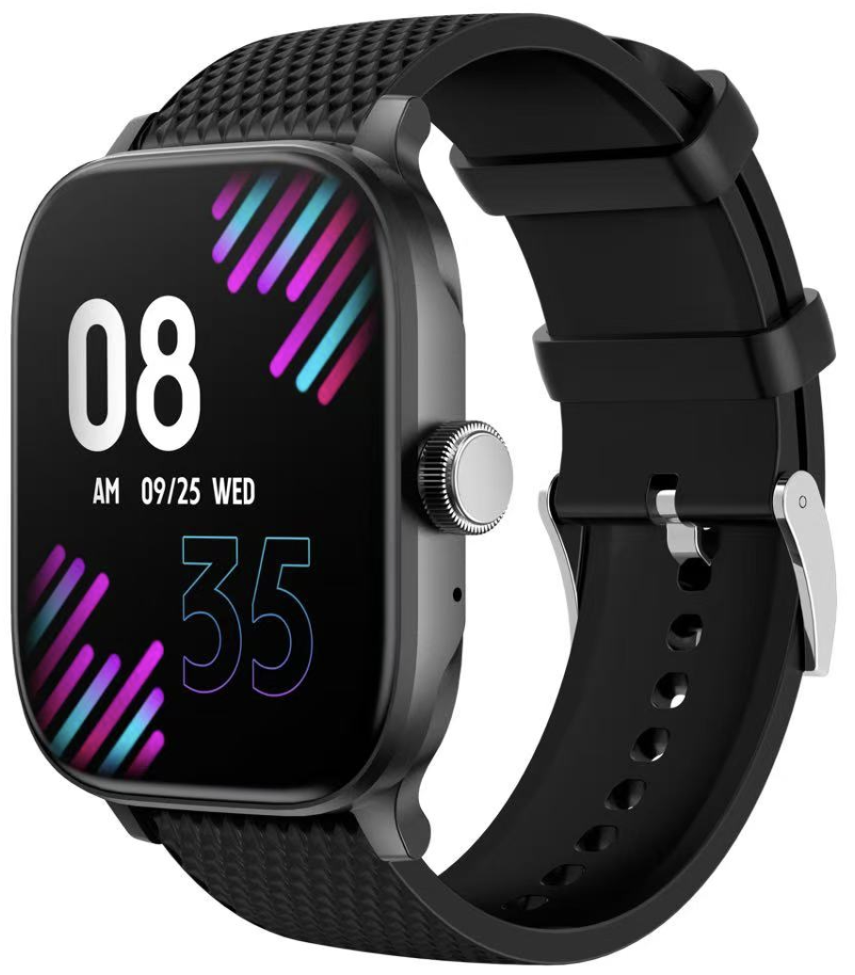
Oct
Proton Smartwatch - XtenFit
Features:
Chipset: JL AC7012F4
LCD: 2.01 inch screen 240x296
Real heart rate LC09A
Touch: full touch
Battery capacity :180mAh
Case material: PC plastic with UV finish Strap color: black silicon
Buckle color: black plating
APP: Co Fit
Item Code – 751240
Item - Proton Smartwatch - XtenFit
MRP -

Slide 25
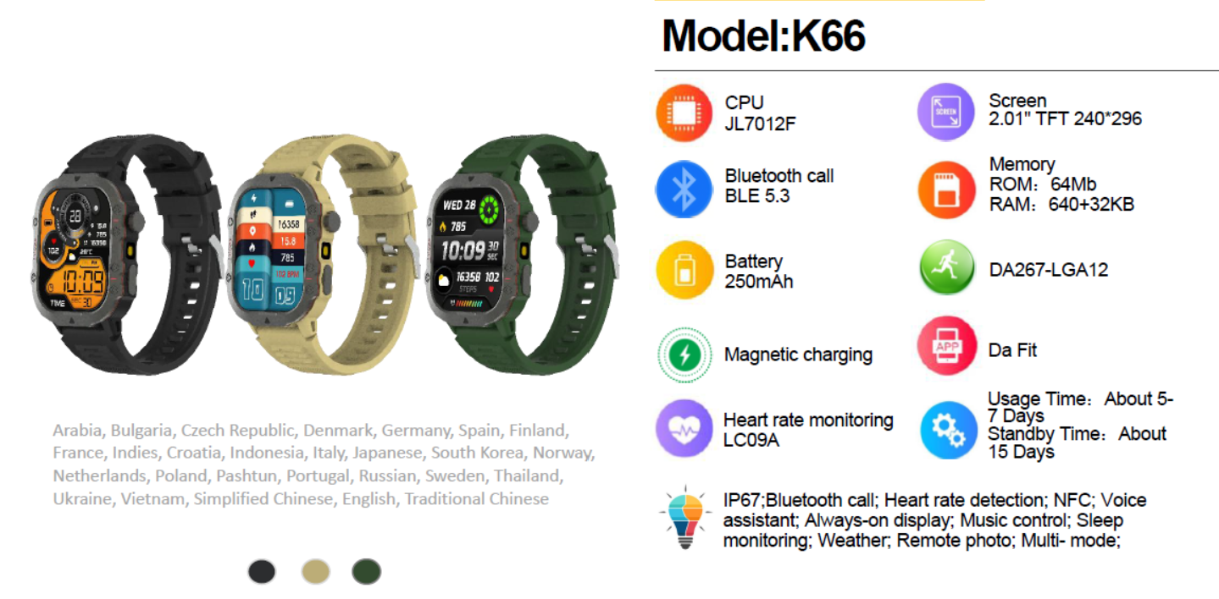
Nov
Proton Smartwatch - XtenFit
Features:
Chipset: JL AC7012F4
LCD: 2.01 inch screen 240x296
Real heart rate LC09A
Touch: full touch
Battery capacity :180mAh
Case material: PC plastic with UV finish Strap color: black silicon
Buckle color: black plating
APP: Co Fit
Item Code – 751240
Item - Proton Smartwatch - XtenFit
MRP -

Slide 26
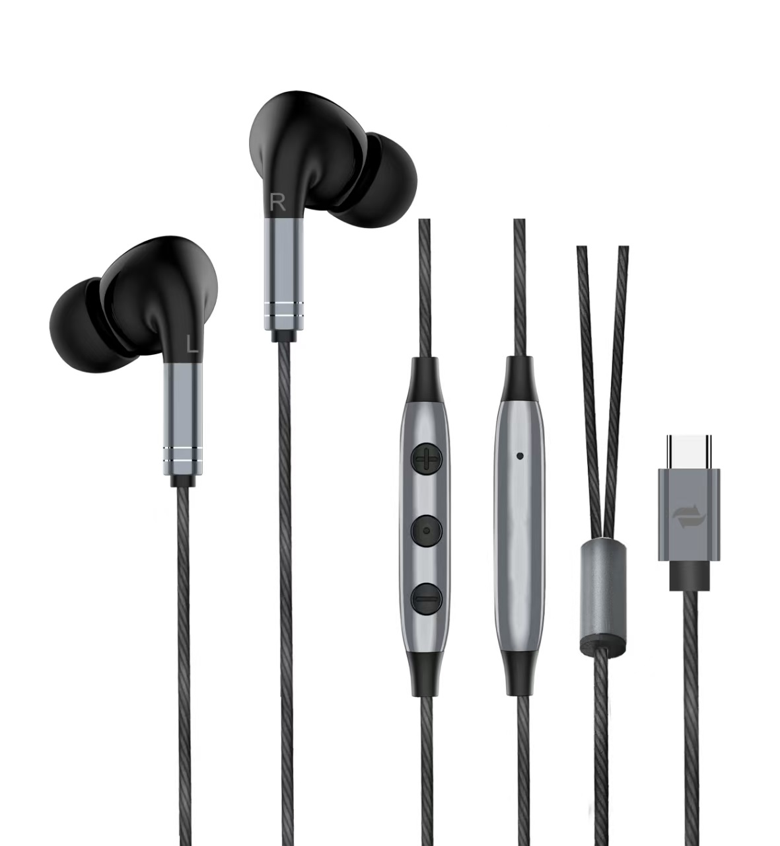
Nov
Proton Earphone – X Beat C
Features:
Speaker diameter:Ф10mm
Sensitivity:­42±3dB
Impedance:16Ω±15%
Frequency response:20-20000
Hzmicrophone:pcB+4015
length:1.2m
Jack: Type C
Two side with mic button
Type C
Item Code –
Item - Proton M-Earphone X-Beat C
MRP -

Slide 27
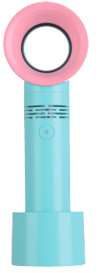
Proton Mini Fan – AirDior
Portable USB Rechargeable Bladeless Mini Fan/Handheld Cooling Dryer, Essential Eyelash Extension Supplies
Nov
Color | Blue, Pink
Electric fan design | Mini Fan with Base
Battery Capacity | 1200 mAh
Product Dimensions | 3.5"D x 1.6"W x 7.3"H
Special Feature | Bladeless, Vortex Action
Noise Level | 20 dB
Wattage | 5 watts
Speed | 29000 rotations
Voltage | 5 Volts (DC)
Switch Type | Push Button
Item Weight | 0.180kg
Control Method | Push Button
Light Type | N/A
Connector Type | USB Type B
Highlighted Features :
Safe for kids, pets, and hair; smooth airflow without exposed blades
Low-noise motor ideal for office, study, or bedtime use
Detachable Base Stand – Can be placed on a desk or used handheld.
Multiple Speed Settings – Adjustable airflow to suit different cooling needs
Item Code –
Item - Proton Mini Fan - AirDior
MRP -

Slide 28
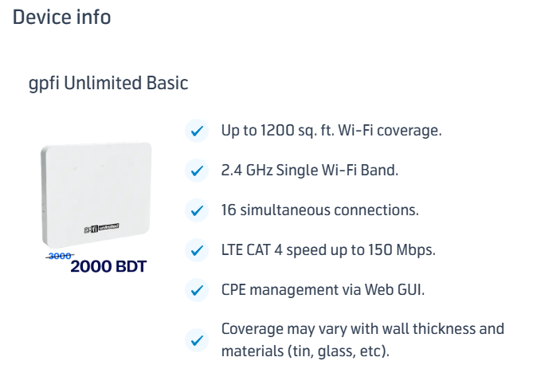

Slide 29
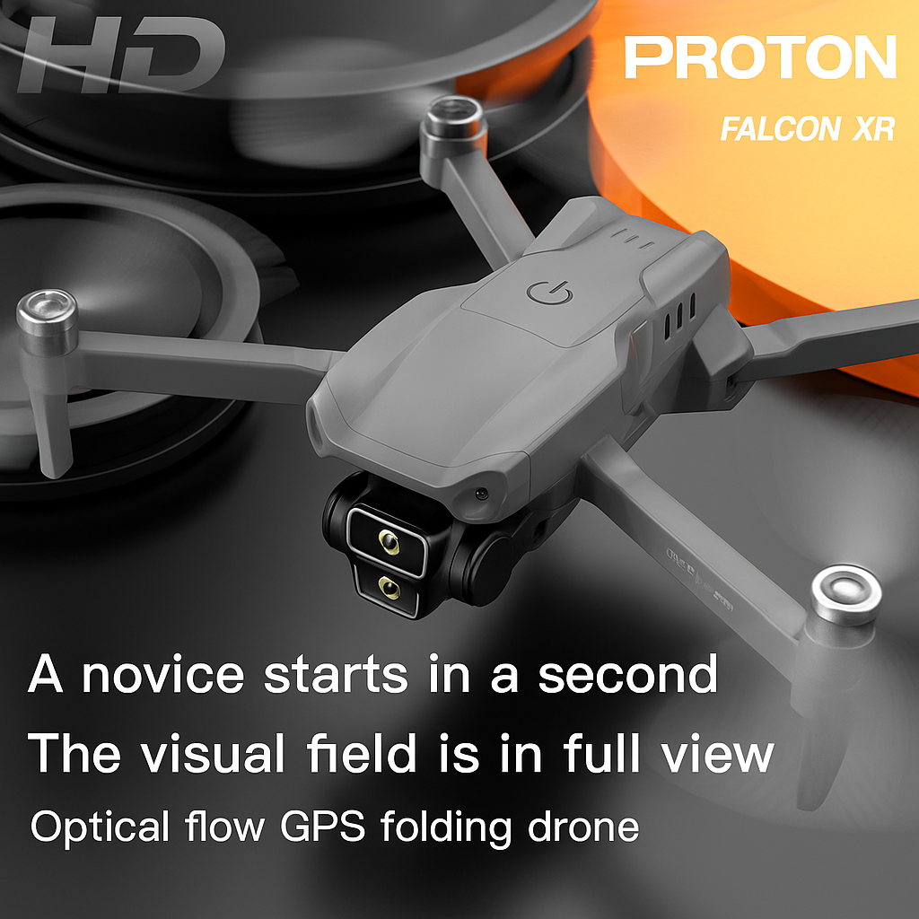
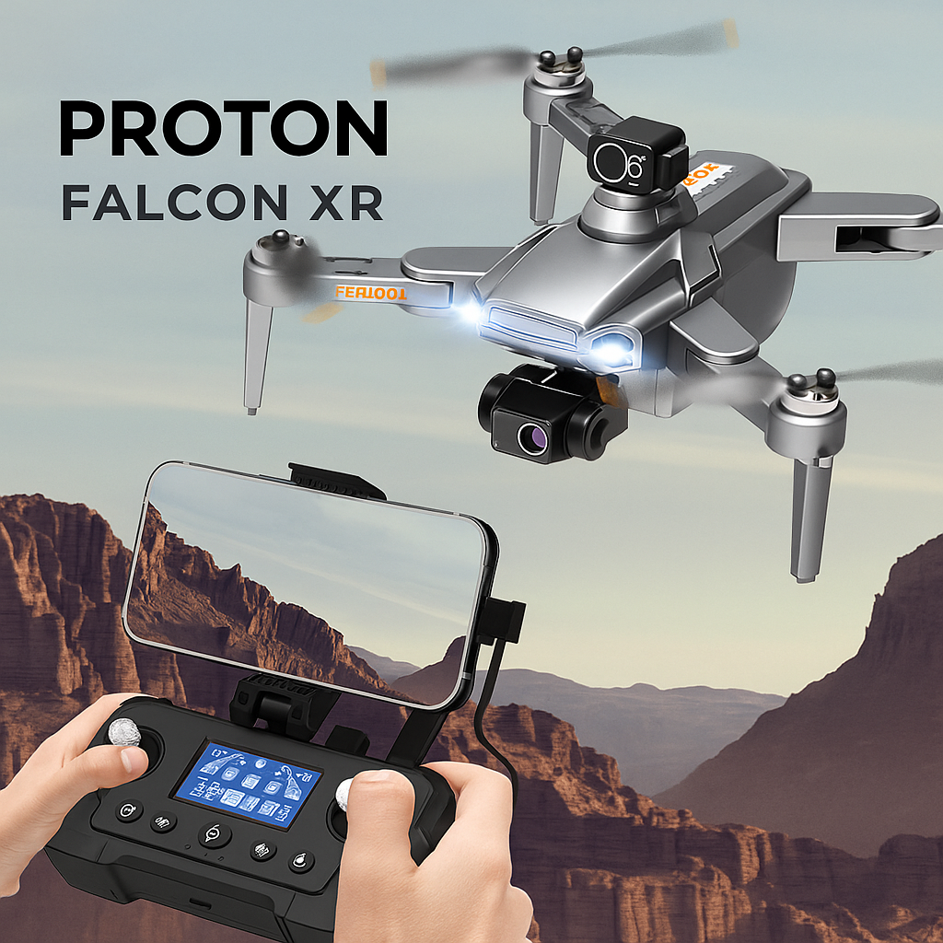
Model : Drone – Falcon XR

